Slide 1



The OMA’s WorkAdvance Strategy
January 21, 2025

Slide 2


Offers workforce development services to organizations committed to building a more equitable economy.
About Me
Over 20 years in organizational leadership with a large-scale workforce development organization in NE Ohio. Placed 400-600 new workers into careers annually. Focus on career advancement through longer-term career coaching
Five years as a workforce development consultant:
  Led career coaching learning community in Ohio
  Oversaw new and incumbent worker programming for a WORC grant in Ohio and western PA
  Provide workforce development support for industry-specific, career pathways initiatives
  Subject matter expert on WorkAdvance for an EDA Good Jobs Challenge grant

Slide 3
S
Beth Hahn
Statewide WorkAdvance Strategy
Sr. Director, OMA Workforce Services

Slide 4


OUR MISSION
PROTECT & GROW
OHIO MANUFACTURING

Slide 5

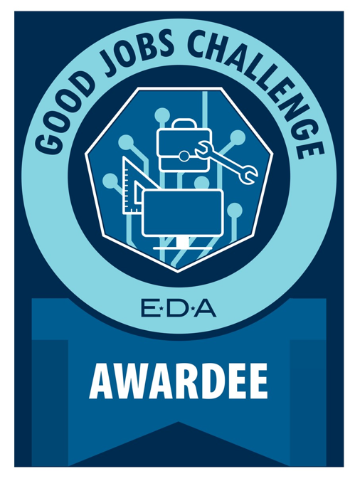
GJC OPPORTUNITY
  $23.4 million in September of 2022
  Goal of 6000 people trained, 3600 placed in good jobs, 50% untapped talent;
  Focus on recruitment innovation:
    Incorporates lead generation, nurturing, and conversion;
  WorkAdvance:
    ISPs are key implementation partners
  Upskilling and Technology Innovation; and
  80 Implementation Partners:
    Extensive collaboration among state agencies, 16 ISPs, and local implementation partners.

Slide 6
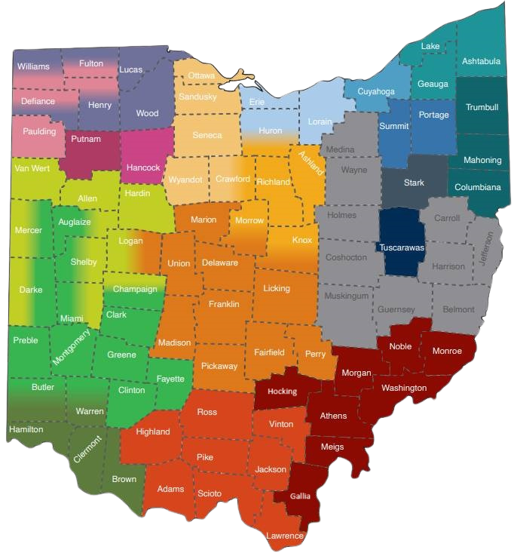
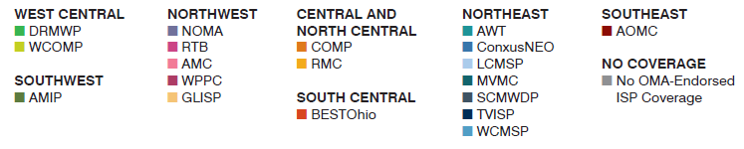

THE OMA-ENDORSED ISP NETWORK
  19 OMA-Endorsed ISPs
  79 / 88 counties covered in the network…and growing
  1,200 manufacturers involved in local ISPs across Ohio

Slide 7
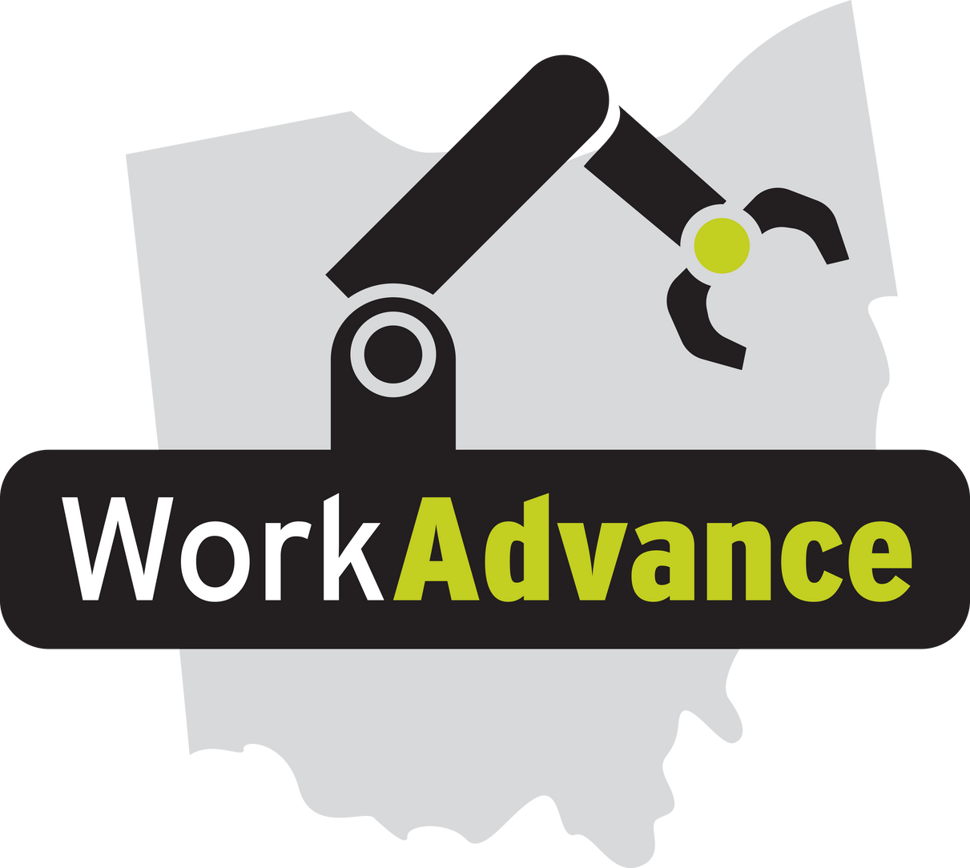
WORKADVANCE ADVANTAGES
For Employers:
  Statewide manufacturing recruitment structure;
  Innovative recruitment strategies
  Increased pool of qualified applicants = untapped talent;
  Applicants prepared with manufacturing fundamentals; and
  Grant-funded career coaching to support workers.
For Jobseekers:
  Higher wages and benefits;
  Stackable credentials for upward mobility;
  Predictable hours, job stability; and
  Career coaching and support.

Slide 8
Chelsea Mills
WorkAdvance Deep Dive
Principal
The Chelsea Mills Group

Slide 9
WorkAdvance is a customizable career pathway model that connects workers to high demand sectors that offer quality jobs with opportunities for advancement.
WORK
ADVANCE
Sector specific programming
Long-term career coaching
Job readiness and technical skills training
Wrap-around supports
MODEL INTEGRITY

Slide 10
Two years later, WA participants earned $5k more than the control group.
Positive cost benefit analysis – $2 return for every $1 invested.
TESTED AND PROVEN
Launched in 2011
Over 700 people in research study – half received services; half did not.
Program participants were 50% more likely to work full-time in targeted sector.
Seven years later, WA participants are more likely to earn $40k/year than the control group.
Notes:
Attachment to the workforce and specifically the manufacturing industry

Slide 11
Employer Partner
Characteristics
Competitive wages and benefits
Advancement opportunities
Has or is interested in building career pathways
Recognition that the current candidate pool is insufficient
Will look in new places for job seekers
Will support training initiatives to develop workers
Will provide an organizational champion to support program
Commitment to interviewing candidates
Views career coaching as an asset
Commitment to living wages
Interest in a broader candidate pool
Invested in WorkAdvance

Slide 12
WorkAdvance Career Pathway
(Job Seeker Perspective)
RECRUITMENT
SCREENING
CAREER READINESS
TECHNICAL SKILLS
JOB PLACEMENT
RETENTION & ADVANCEMENT
Ensures candidates will benefit from training and can meet employer requirements
Includes workplace skills, soft skills and
math brush-up
Technical skills training for industry-recognized credentials, OJT training
Facilitates entry into jobs and acclimation to the workplace
Supports job performance and career mobility after initial placement

Slide 13
Career Coaching
Key service provider throughout model
Supports completion of job readiness and tech training
Develops individual goal plans with participants
Contributes to job placement; supports retention and advancement
  Partner Characteristics
    Experience working with both employers and job seekers
    Understanding of career pathways and career ladders
    Proven protocols and tracking systems for job placement and retention recordkeeping
    Access to emergency assistance and supportive services

Slide 14
New Worker Customizations

Slide 15
Adult Job Seekers
Designed for adults interested a career in manufacturing and willing to participate in short-term training
Ideal for companies interested in expanding and diversifying their candidate pool
With optimal partnerships, programming can be launched relatively quickly and once a pipeline forms, a new group of prospective employees will be available monthly
Participant outreach and recruitment should include several strategies – marketing blitz, grassroots efforts and referrals partnerships with local CBOs
Based on targeted recruitment strategies, many population-specific iterations of this model are possible
Companies with “Good Jobs”
Outreach
Screening
Career Readiness Training
Technical Skills Training
Job Placement
Advancement
4 – 8 Weeks
3 – 6 Weeks
MONTH ONE
MONTH TWO
Career Coaching

Slide 16
High School Seniors
Designed for seniors with an undefined plan for education or employment after graduation
This model is time dependent. Seniors are identified early in the academic year and skills training is integrated into their academic work, job placement directly following graduation
For outreach, partner with secondary schools, ideally where graduates are less likely to go on to college or enlist in the military
Though this model can take an entire academic year to yield new employees, benefits include a steady stream of eager young workers who can be oriented to your workplace culture.
Companies with “Good Jobs”
Career Exposure
Screening
Career Readiness Training
Technical Skills Training
Job Placement
Advancement
Fall Semester
Spring Semester
After Graduation
MONTH ONE
MONTH TWO
Career Coaching

Slide 17
Justice Impacted Prerelease
Designed for participants with justice system involvement who are in a corrections facility
Identify companies willing to hire recently released program participants; have a clear set of accepted/non-accepted backgrounds
In partnership with a corrections facility, recruit individuals who are soon to be released. Provide career exposure to ensure interest in a manufacturing and cross-reference the job opportunities with the individual’s background
To minimize program attrition, skills training and establishing a relationship with the career coach should take directly prior to release
Companies with “Good Jobs”
Career Exposure
Screening
Career Readiness Training
Technical Skills Training
Job Placement
Advancement
Pre-release
Post-release
Career Coaching (with additional supports)

Slide 18
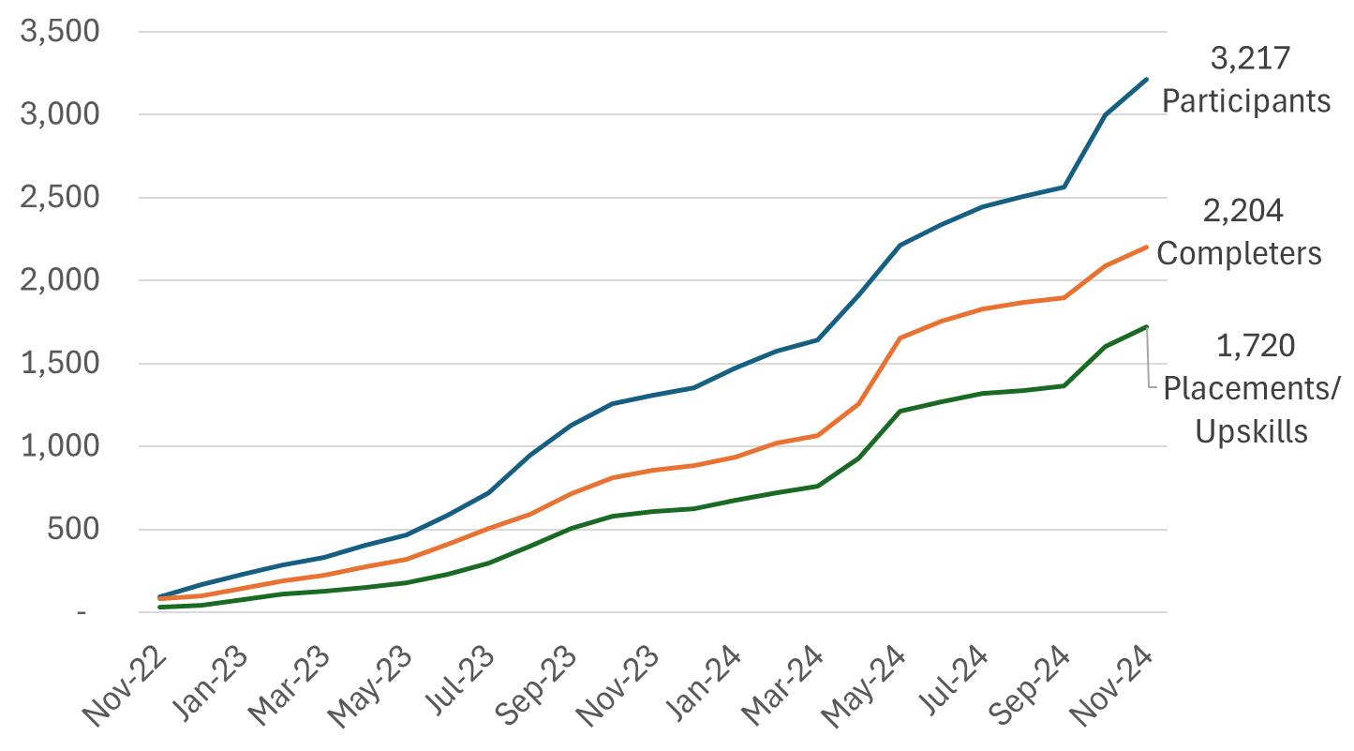
OUTCOMES TO DATE

Slide 19
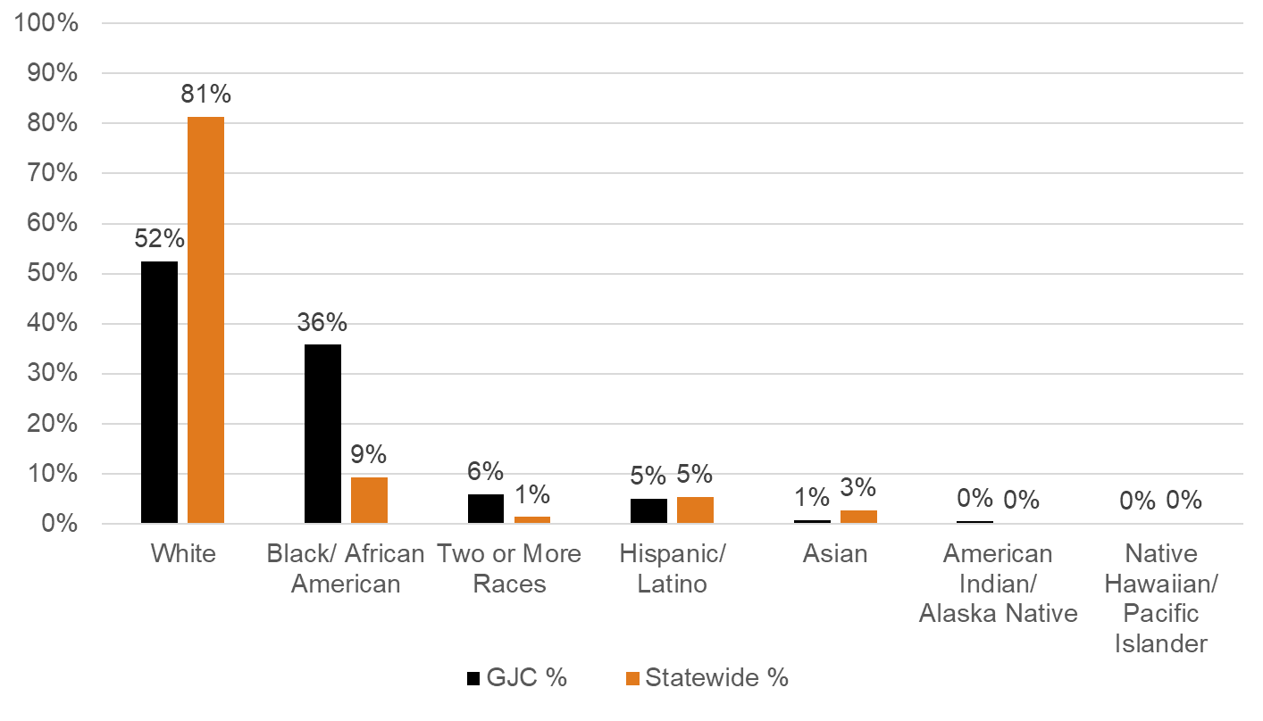
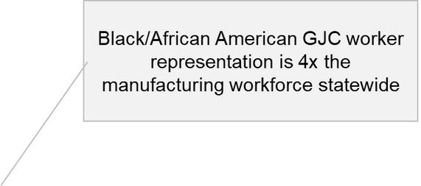
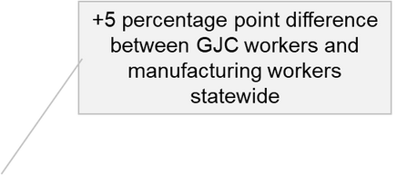
OUTCOMES TO DATE

Slide 20
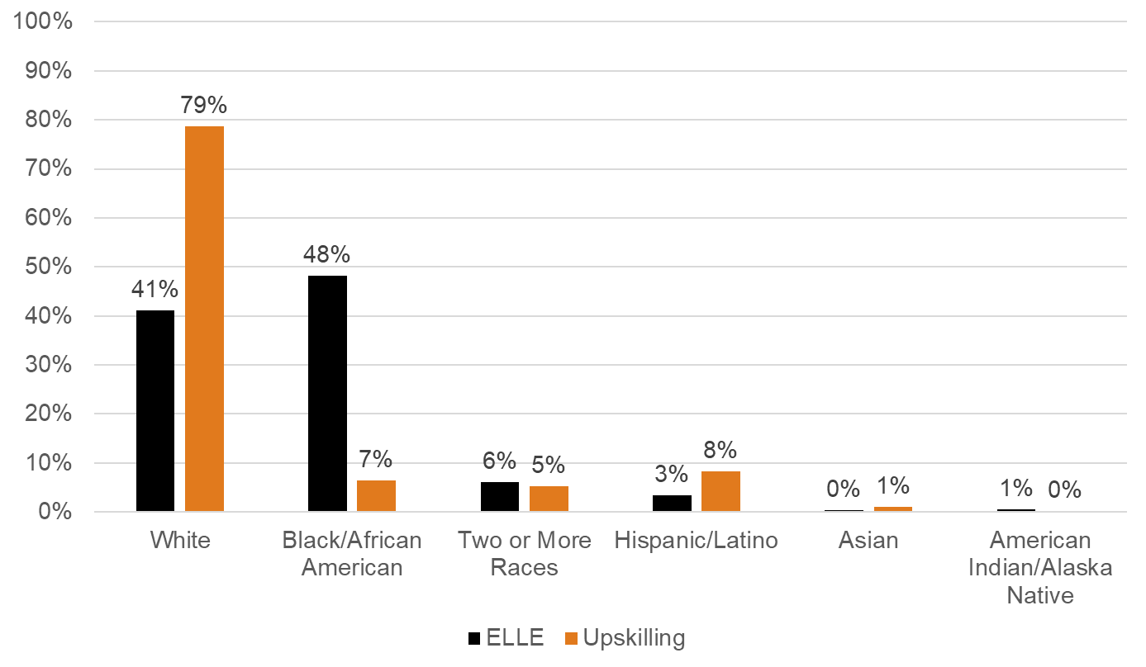
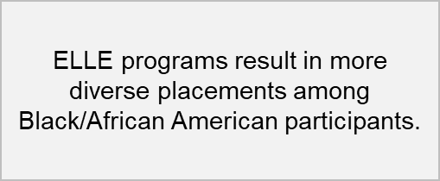
NEW WORKER VS. UPSKILL

Slide 21
TOP CREDENTIALS
Certified Manufacturing Associate (CMfgA)
CPT 4.0
FANUC Robotics
WISE Pathways
OSHA

Slide 22
QUESTIONS?
Questions?
Contact Info
Beth Hahn, Senior Director
The Ohio Manufacturers' Association
bhahn@ohiomfg.com

