Slide 1














Ohio Technical Skills Innovation Network
Ohio TechNet Monthly Meeting
MAY 2025
Date: May 20, 2025
www.ohiotechnet.org

Slide 2


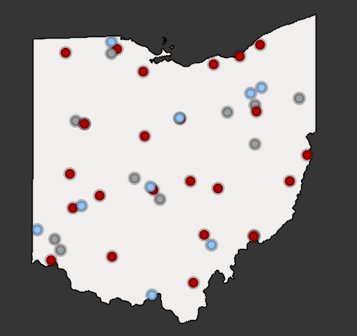


Vision
Partners in Training Ohio’s Manufacturing Workforce
The members of the Ohio Technical Skills Innovation Network, or Ohio TechNet, are nationally recognized for partnering with industry to implement collaborative, innovative solutions that meet manufacturing and tech workforce needs.
Mission
Ohio TechNet supports workforce development and academic professionals to incubate, develop and sustain programming that accelerates the growth of Ohio’s manufacturing & technical workforce.
OTN Members:
Community College
Technical Center
University
Purpose
Ohio TechNet partners benefit from peer-to-peer collaboration, technical assistance and access to resources, making program expansion and innovation at their institution more efficient, faster to implement and easier to sustain.

Slide 3
Strategic Focus
Areas
Guided Pathways for Youth
Reaching New Audiences
Innovative Earn and Learn
Faculty and Educator Development
Ohio TechNet’s strategic focus areas provide partners with best practices, models, and technical assistance to address the critical workforce needs in the state
Partnering with Industry

Slide 4
You’ve just won an all-expenses paid trip-but you have to leave in 5 minutes.
Where are you going?
MORNING
ICEBREAKER

Slide 5

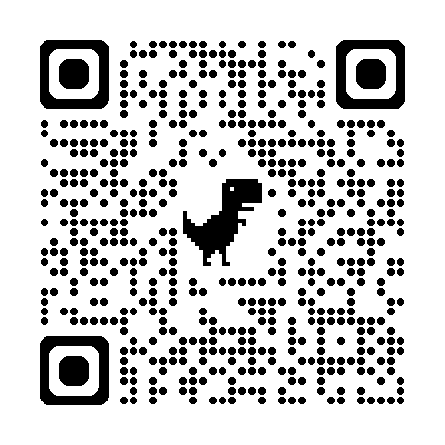
Thank you to everyone that attended on April 30th!
Post-Event Recap is Available!
Event Materials, Pictures, and more!
https://ohiotechnet.org/our-consortium/10-year-celebration/

Slide 6

FOLLOW
OHIO TECHNET
ON LINKEDIN!
Notes:
https://www.linkedin.com/company/ohio-technet/?viewAsMember=true

Slide 7



TODAY’S AGENDA
SEMI Foundation Update:
  Patrick Gillen will share the latest developments from the SEMI Foundation and The National Network for Microelectronics Education.
Career Technical Education (CTE) Overview:
  Brett Doudican, Greene County Career Center, will provide an insightful overview of Career Technical Education (CTE).
Careers in the Community: Joy Wolfel and Jen Bernett, Mid-East CTC, will introduce an inspiring elementary-level program designed to ignite students’ curiosity about future careers.

Slide 8
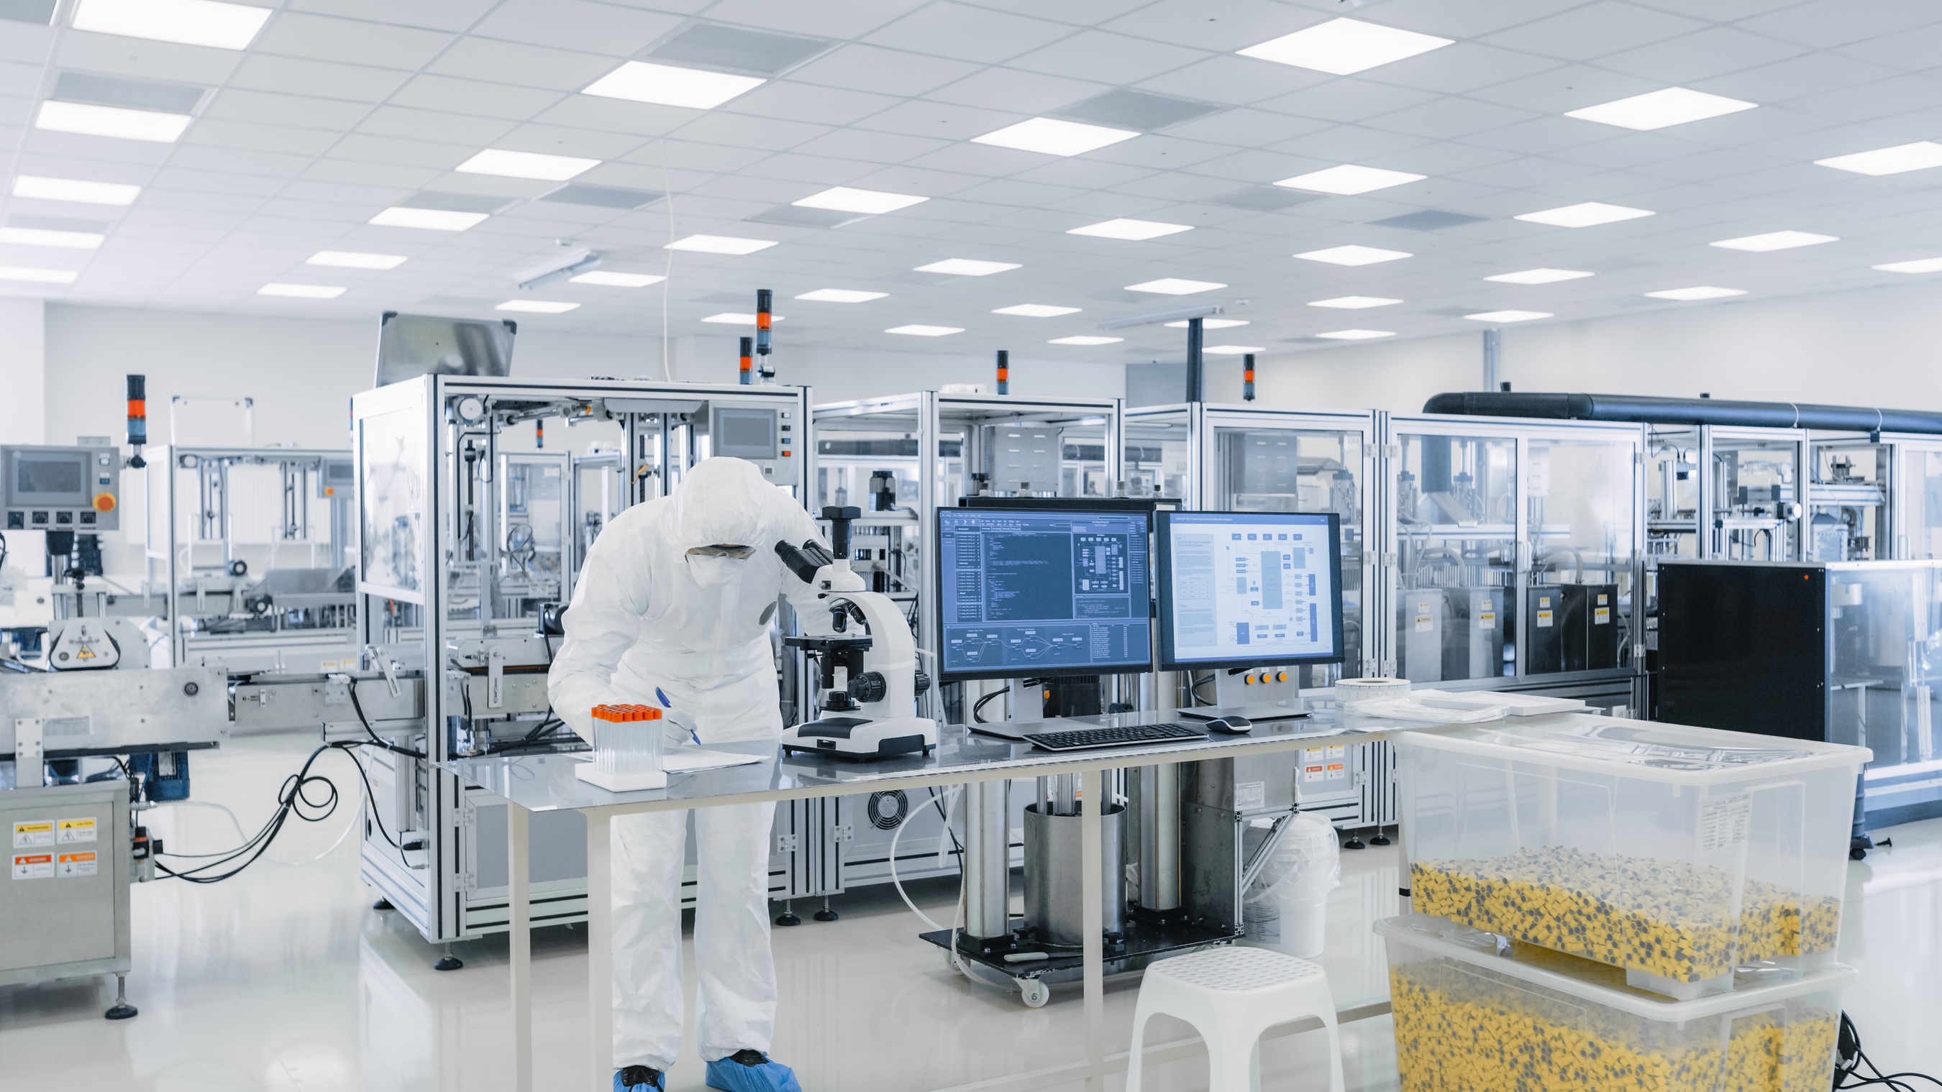


The National Network for
Microelectronics Education
April 30, 2025
Patrick Gillen
Program Manager, WFD & Special Projects
SEMI Foundation
pgillen@semi.org
Notes:
The SEMI Foundation is the Coordination Hub for the National Network for Microelectronics Education (NNME). The NNME is an initiative to train the future semiconductor workforce, encompassing all levels of education and industry roles, through the Hub and regional nodes. The NNME aims to address the anticipated shortage of skilled workers in the microelectronics industry by creating a coordinated national network for education and workforce development.
As the Hub, the SEMI Foundation will oversee regional nodes and connect with other national semiconductor WFD programs and investments to offer curricula, instructional materials, industry awareness and outreach, and experiential opportunities to students and jobseekers across the U.S. The NNME will focus on developing a skilled microelectronics workforce, ensuring that education and training align with industry needs.

Slide 9



SEMI and SEMI Foundation
SEMI
SEMI Foundation
Industry Advocacy and Collaboration
Acts as a unified voice on policy and regulatory issues, promoting fair trade, open markets, and industry-friendly standards.
Standards and Best Practices
Develops and maintains a wide range of technical standards to ensure compatibility and increase production efficiency for manufacturing.
Events and Networking
Organizes global trade shows and conferences, from SEMICON, to ISS where industry professionals, business, and government gather.
Market Research and Insights
Provides market intelligence, reports, and industry forecasts covering equipment, materials, fab capacity, and emerging technology trends.
Workforce Development Programs
Develop & manage initiatives designed to inspire students and job seekers to explore careers in microelectronics
STEM Education and Outreach
Illuminating our industry to young people, inspiring careers in microelectronics and related fields.
Broadening Access to Electronics Careers
With talent shortages ongoing and increasing, industry is in competition for previously untapped pockets of the labor market.
Partnership Building
Convenes academia, industry, and communities to ensure the semiconductor sector has a robust pipeline of workers.

Slide 10

SEMI Workforce Development
Implementation
Industry image & awareness programs and assets to illuminate educational pathways and careers
Educator training to boost industry knowledge
Hands-on training for students
Advocacy for workplace culture and worker voice in all programs
Customized programs for members of the military community, women, and other underrepresented communities to build a larger and more diverse talent pool
Expanding programs for new and incumbent workers, including through SEMI U
Intermediary services to unite industry, academia, workforce agencies, and government in support of Workforce Development
Support for member companies in creating workforce development plans, childcare plans, and equity strategies

Slide 11
NNME: Areas of Focus
1
2
3
Curriculum & Training
Industry Awareness
Network & Access
Inventory ME Curriculum
Modernize Training Programs
Digital Resource Portal
Workforce Supply & Demand Mapping
Educator Technical Support
National Awareness Campaign
Disseminate Outreach Toolkits
Industry Awareness Portal
Support National Workforce Network
Elevate Best Practices
Collaborate Across Federal Investments
Notes:
The NNME will have three primary areas of focus: developing, modernizing, updating, and making accessible semiconductor curriculum and training opportunities; generating industry awareness for all Americans; and supporting a national network to reduce duplicative efforts and weave together semiconductor educational resources.

Slide 12
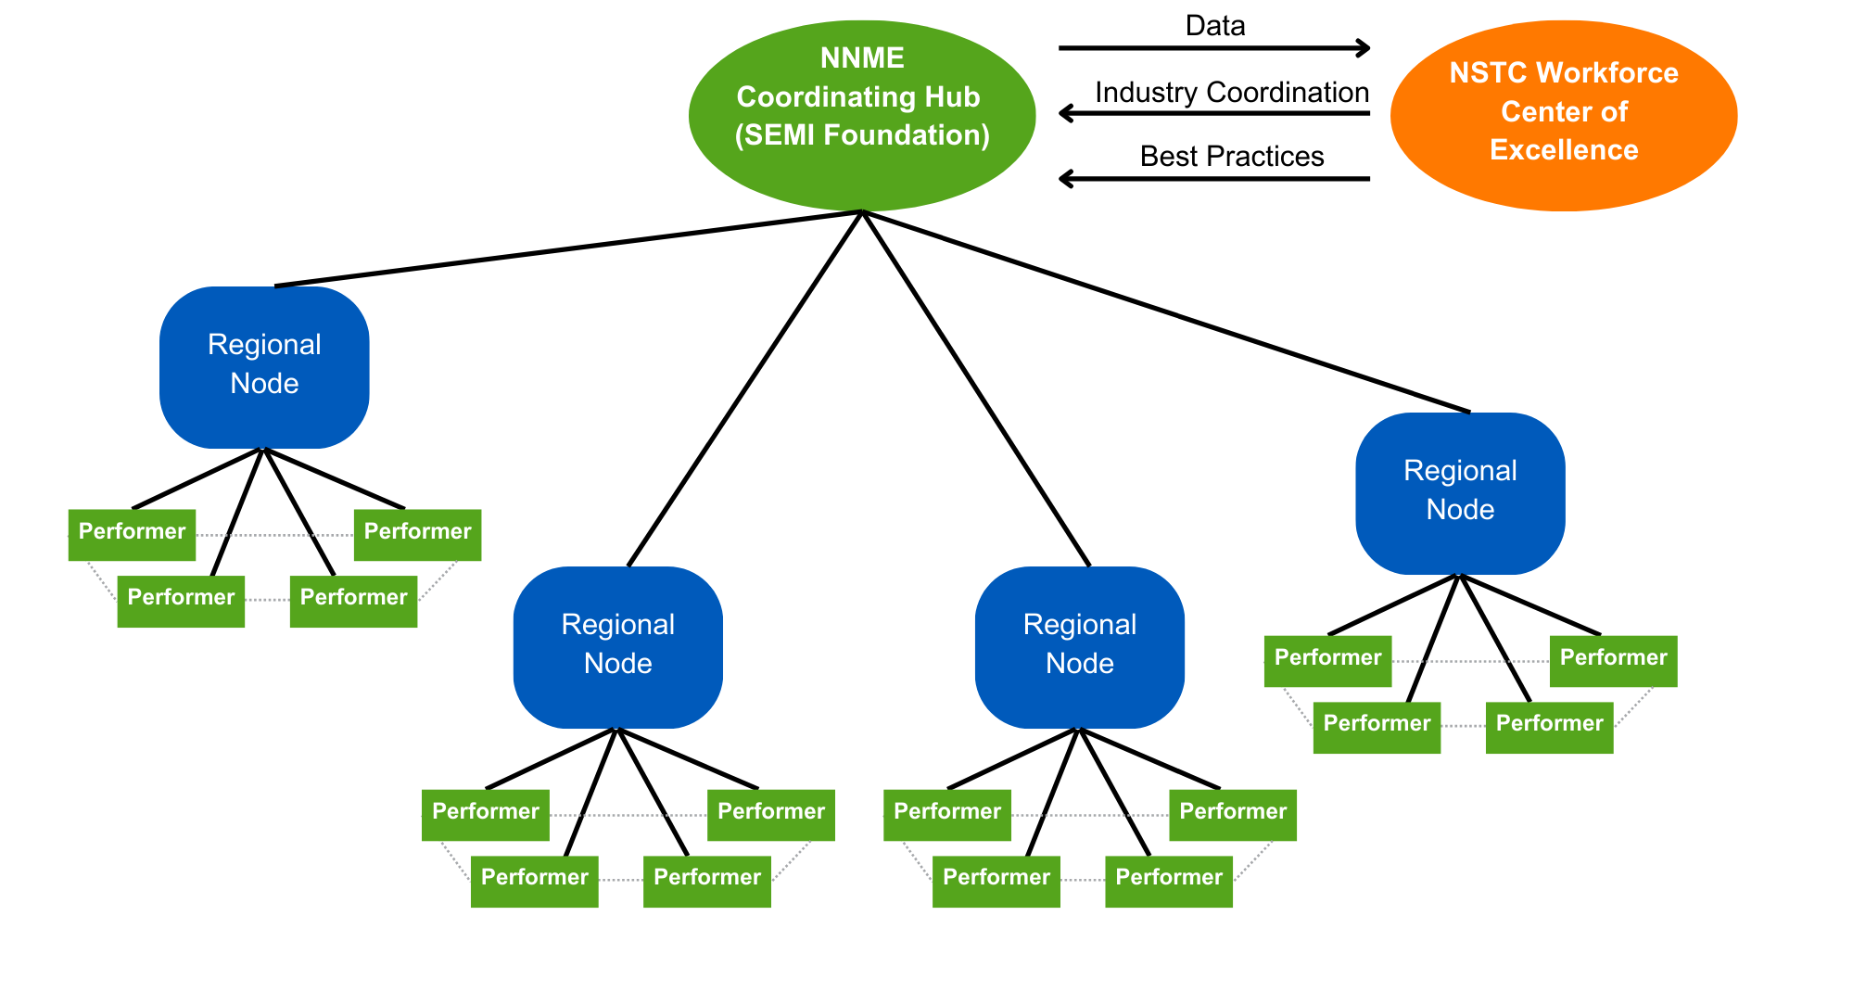

NNME: Organizational Elements
Notes:
As the Hub of the National Network for Microelectronics Education, the SEMI Foundation will be coordinating three major efforts: the development and management of Regional Nodes across the country who will coordinate and collaborate to update and modernize curriculum and provide industry/career outreach; the creation of a digital hub for curriculum that will reduce duplicative efforts and disseminate content; and a major national industry awareness campaign
SEMI members will be important partners in the Regional Nodes to ensure that all training/curriculum maps to employer needs

Slide 13








NNME: Subawardees & Collaborations
Subawardees
Collaborations
Notes:
The SEMI Foundation is currently working with four subawardees: JFF, MNT-EC, IEC, and HBCU CHIPS Network to support the launch and design of the NNME and the process for choosing Regional Nodes. The NNME will also collaborate closely with the WCoE, ME Commons, SmartUSA, and other federal programs to ensure the NNME is leveraging broad thought partnership for its launch and operations, to ensure efforts are not duplicated, and to make NNME resources as widely available as possible.

Slide 14
NNME: Year One Timeline
NNME infrastructure built
Node Competition
Buildout of web presence and portals
Nodes Selected
Industry awareness campaign fully launched
Q4
NNME Team Hired
Q1
Q1
Q2
Q2
Q3
Q2
Governance boards established
Q3
Media campaign underway
Q3
WFD supply & demand studies completed
Q4
Online Job Tool launched
Q4
Initial assessments underway
Q4
First nodes operational
Notes:
General timeline of Year One. We expect to establish at least four regional nodes in Year One and to hold the second round of node applications for the final set of Nodes in Q1 or Q2 of Year Two.

Slide 15







NNME: Get Involved
Please join us!
Spread the word about NNME to your educational networks
Join an NNME Node application
Identify and connect with fellow performers in your region
Contribute thought partnership to Hub/Node buildout
Invite NNME team to your events
Highlight modernized curriculum and programming to NNME
Sign up for NNME Newsletter

Slide 16
NNME: Contact Us
Questions or want to get updates?
Email nnme@semi.org to be added to mailing list
Website coming in May

Slide 17
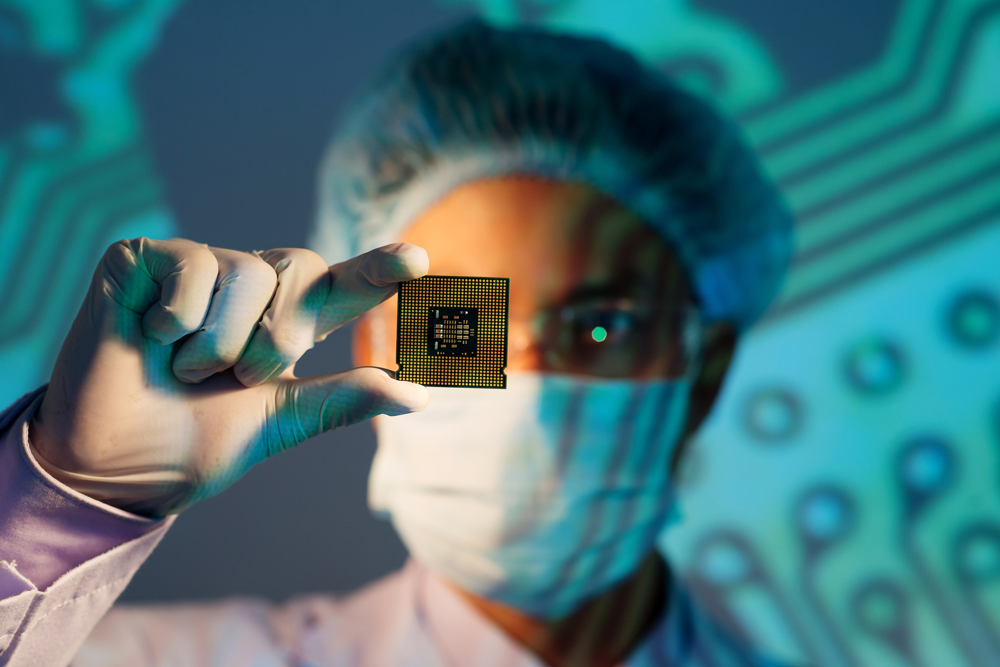
Thank you!
Patrick Gillen
Program Manager, WFD & Special Projects
SEMI Foundation
pgillen@semi.org

Slide 18


Career Tech in Ohio
Brett Doudican

Slide 19

Origin Story
Career Technical Planning Districts
Geographically arranged across the state
Three Delivery Models
Joint Vocational School Districts (JVSD)
Compacts
Comprehensives
Ohio Technical Centers

Slide 20
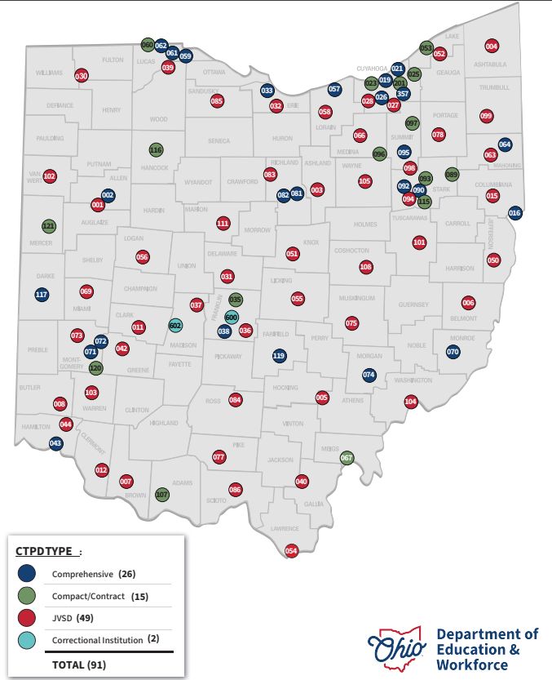

Slide 21
Partnerships
Mix of delivery models/locations within the models
Main Campus
Auxiliary Campuses
Shared Campus
Satellite Location
Providers – K12 vs. CTPD
Alignment with external partners
Post-Secondary Partners
Apprenticeships
Advisory Committees

Slide 22
Programming Models
Career Exploration
Middle School Programming
Satellite Programming
Main Campus Programming
Career Training
Senior Only Programming
Industry Recognized Credentials
Job Training Coordination
OTC+
OTC

Slide 23

Programming – A closer look
Teaching and Learning Content Standards
CTSO
Work Based Learning
Industry Recognized Credentials
Points system
College Credit
CTAG – ITAG
CCP
Articulated/Bilateral
Credit Flex
Complementary Academics

Slide 24
Funding
State Share
Local Property Taxes
Perkins V
Equity
New programs
Grants
Business Support

Slide 25




Organizational Supports

Slide 26

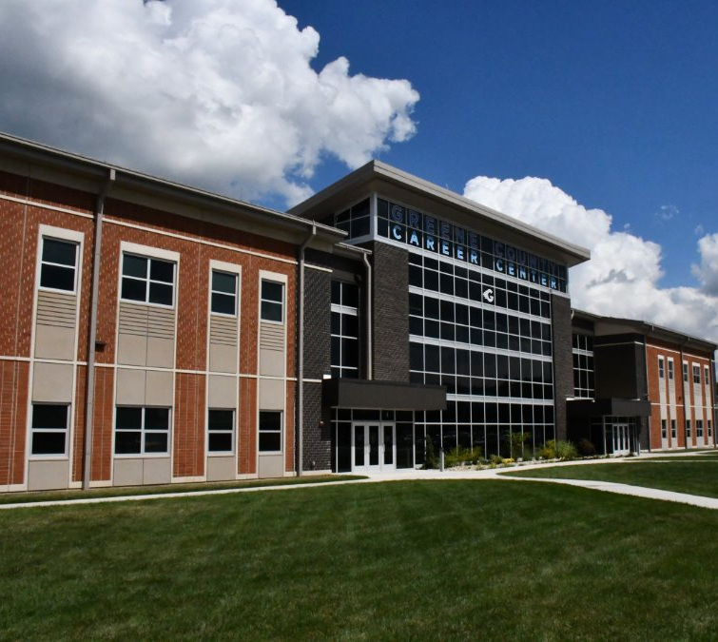
About GCCC
Xenia Ohio

Slide 27
Serving over 4,000 students in Greene County
2024 Greene County Career Center
Main Campus
22 Workforce Development Programs
3 Transition to Workforce Programs
4 Academics Content Areas
1 Adult Education OPOTA Program
14 Satellite Campuses
19 GCCC Programs
8 CTPD Programs
2 Auxiliary Campuses
AMT @ GC Airport
Project Search @ Soin Hospital
Career Exploration Resources for all Kindergarten, 2nd Grade, and 4th Grade Students in the County (~5000 students)

Slide 28

Connected
Over 400 Business and Industry Advisors
8 Articulating Colleges
9 Apprenticeship Pathways
Community Connections and Service
Global Vision, Local Impact
  Honda EV Battery Plant
  Material Science: AFRL & UDRI
  Green Energy: Greenhouse project
  Ohio UAS Center

Slide 29

Innovative and Accomplished
5 Star Rating
  Career: Over 200 students completing internships/Work Based Learning, over 300 students earning 12 points in credentials
  College: $3000 TechPrep Scholarship
  Military: Purple Star School
Recruitment and Enrollment at an all-time high
Innovative
  CTSO – Several National Competitors
  Employability
  Programming Options – healthy balanced plate
Challenges
  Growth, Quality, and Sustainability

Slide 30
Intentional Alignment Model
Elementary K-6
STEM Activities and resources
Micro-Grants
Middle School 6-8
STEM Camp
Middle School Engineering Programming
Mix of Satellite GCCC and District Owned
PLTW Robotics, Flight and Space, Introduction to Engineering Design
High School 9-12
Satellite Engineering Courses
Career Center
Manufacturing Academy
Advanced Engineering Systems
Robotics and Automation
Welding and Metal Fabrication
IRC Only programming – OTC+
Robotics Yaskawa Motoman Operator, Programming
Adult
Customized Training with QQE
DRMA, Clark State, SOCHE

Slide 31

Advanced Engineering Systems
CTSO
  SkillsUSA
Work Based Learning
  School Based Enterprise
  Internships/Pre-apprenticeships
Industry Recognized Credentials
  Preferred
    OSHA10
    Lean Six Sigma
  Valued
    CSWA
    Haas Basic Milling
    Certified Additive Manufacturing Fundamentals
    Ohio Recognized Pre-apprenticeship
  Recognized
College Credit
  Sinclair Short Term Certificate – Additive Design Specialist
  Worked with Sinclair to be within 4 courses of an Associates in Manufacturing Engineering Technology
  TechPrep Scholarship – 2+2 with UD/Wright State
Complementary Academics
  Material Science

Slide 32
Questions?
Brett Doudican – bdoudican@greeneccc.com

Slide 33
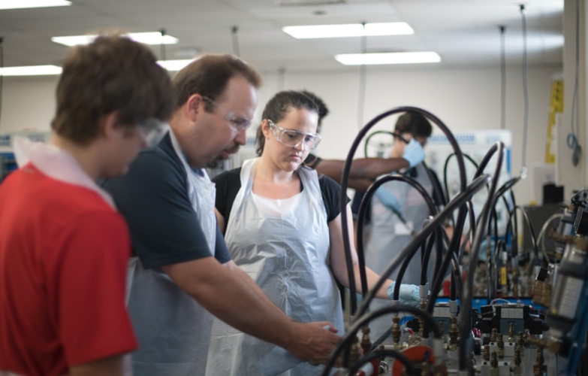

Partners in Training Ohio’s Manufacturing Workforce
June OTN Meeting
June 17, 2025 at 8:30am

