Slide 1














Ohio Technical Skills Innovation Network
MARCH 2025
Peer-to-Peer Collaboration
Access to Valuable Resources, Trainings, and Events
Innovative Program Models
Date: March 18, 2025
www.ohiotechnet.org

Slide 2




REMINDER:
Based on a request from our IT Department, Ohio TechNet will be not allowing the use of AI Meeting Assistants in our meetings

Slide 3

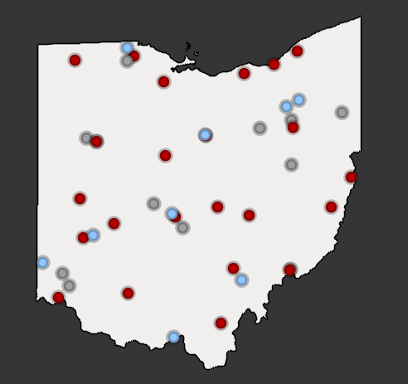
Vision
Partners in Training Ohio’s Manufacturing Workforce
The members of the Ohio Technical Skills Innovation Network, or Ohio TechNet, are nationally recognized for partnering with industry to implement collaborative, innovative solutions that meet manufacturing and tech workforce needs.
Mission
Ohio TechNet supports workforce development and academic professionals to incubate, develop and sustain programming that accelerates the growth of Ohio’s manufacturing & technical workforce.
OTN Members:
Community College Career Technical Center University
Purpose
Ohio TechNet partners benefit from peer-to-peer collaboration, technical assistance and access to resources, making program expansion and innovation at their institution more efficient, faster to implement and easier to sustain.

Slide 4
Strategic Focus Areas
Guided Pathways for Youth
Reaching New Audiences
Innovative Earn and Learn
Faculty and Educator Development
Ohio TechNet’s strategic focus areas provide partners with best practices, models, and technical assistance to address the critical workforce needs in the state
Partnering with Industry

Slide 5

MORNING ICEBREAKER
Notes:
What is your favorite vacation?

Slide 6

3 Truths and 1 Lie St. Patrick’s Day
What’s the lie??
What’s the lie??
St. Patrick wasn’t Irish
Corned beef and cabbage is an American invention
St. Patrick wore blue, not green
The first St. Patrick’s Day parade was in Ireland

Slide 7
3 Truths and 1 Lie St. Patrick’s Day
St. Patrick wasn’t Irish
Corned beef and cabbage is an American invention
St. Patrick wore blue, not green
The first St. Patrick’s Day parade was in Ireland
The first parade was in America and took place in New York City in 1762
Notes:
What is your favorite vacation?

Slide 8

Innovating, Investing, and Leading Development of the Defense Industrial Base Event A special event recognizing Ohio TechNet and NextFlex Wednesday, April 30th, 2025 | 9:30am – 2:00pm
Lab Tours and Networking Opportunities!
PANEL HIGHLIGHTS
State Perspectives: Education and Industry Working Together for Impact This panel highlights Ohio TechNet members’ critical role in expanding earn-and-learn programs, forming partnerships to meet defense industry talent needs, and bridging education with workforce demands.
Panelists:
﻿
Courtney Tenhover, Manager of Training Projects, Lorain County Community College & Ohio TechNet
Jeff Miller, Senior Vice President, Sinclair College
Jessica Borza, Managing Director of Workforce Services, The Ohio Manufacturers’ Association
John Agostinelli, Robotics & Automation Instructor, Amherst Exempted Village Schools
Moderated by Terri Sandu, Director, Ohio TechNet
National Perspectives: Industry Role in Advancing Innovation in Manufacturing Talent Join thought leaders from Novagard, UES, and EWI as they discuss transformative industry-academia partnerships reshaping workforce strategies and driving technological breakthroughs. Educators and industry professionals will gain actionable insights into critical trends and strategic priorities for building a robust manufacturing talent pipeline.
Panelists:
Mark Norfolk, Director of Government Business Development, EWI
Sarah Nash, Owner and CEO, Novagard
Lucas Beagle, Senior Director, Biological and Nanoscale Technologies Department, Blue Halo
Moderated by Lauren Friedman, Senior Program Manager, Workforce Development, NextFlex
Notes:
https://www.lorainccc.edu/about/innovating-investing-leading-for-the-defense-industrial-base/

Slide 9



OSCN Community of Practice (CoP) Symposium
OSCN Train the Trainer Semiconductor Series
Future Technician Learning Community
FlexFactor Program Growth and Acceleration at Zane State
Future-Ready Educator Bootcamp: Exploring Industry 4.0
Sinclair Community College's Professional Development for the Future of Education
Dayton Digital Transformation Summit

Slide 10


Slide 11
We are excited to open registration to the Spring Community of Practice Symposium on April 11, 2025, at Columbus State!
Register here!
Please join us for a stimulating FREE symposium at Columbus State, this event offers a unique opportunity to connect with instructional teams (including faculty, teachers, administrators, tutors, advisors, and other support specialist), employers, vendors, and project leaders in advanced manufacturing. These professionals are representing community colleges, universities, career centers, K12 institutions, and key stakeholders. Our goal is to foster collaboration, networking, and professional development across Ohio.
At this in-person event, participants can expect to learn more about AI tools and curriculum, technical math discussion, ISP engagement, successful innovative earn and learn models, and much more!

Slide 12

The Ohio Semiconductor Collaboration Network (OSCN)
The OSCN was established September 2023 through Intel SERP grant funding
OSCN represents and supports all Ohio Community and Technical colleges with the Intel SERP grant initiative
The network developed 3 "new" courses for the Semiconductor Technician Fundamentals Certificate:
Manufacturing Fundamentals
Semiconductor 101
Vacuum Systems Technology
These course materials can be found and obtained through OhioLINK: www.ohiolink.oercommons.org

Slide 13

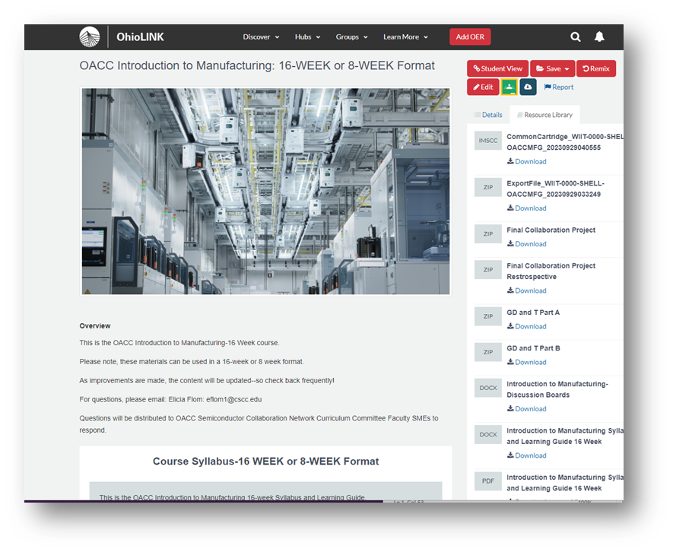
OhioLINK Curriculum Resources www.ohiolink.oercommons.org
Syllabi
Presentation Slides with Lecture Notes
Knowledge Checks (Quizzes, Tests)
Lesson Plans
Learning Activities/Assignments
Lab Activities and SOPs
Blackboard Course Cartridge
Common Course Cartridge
Notes:
Speaker Notes:
All course content are posted on OhioLink
Syllabi
Presentation Slides with Lecture Notes
Quizzes, Tests, and Knowledge Checks
Lesson Plans
Learning Activities/Assignments
Lab Activities and SOPs
Courses are available in 16 week and 8 weeks versions.
Blackboard for Blackboard Cartridge AND Common Cartridge for integration into Canvas, Blackboard, or other LMS’s are available on OhioLINK
Image Support:
CSCC Adobe Stock Images: AdobeStock_76149857

Slide 14
Ohio Semiconductor Collaboration Network Stackable Certificate concept – “Semiconductor Technician Fundamentals Certificate”
Semiconductor Manufacturing Certificate (example)
OIM001 Introduction to Manufacturing
OET 001 DC Circuits
IT Fundamentals+
OSE001 Introduction to Semiconductors and Cleanroom Processing
CTVS001 Vacuum Systems
OET 003 AC Circuits
Basic Mechanisms and Drives
Associate of Applied Science (example)
PLC’s
Motors and Control Logic
PLC
Intro to Environmental Science, Safety and Health
Manufacturing Processes
Digital systems
Semiconductor Mfg. Processes
Engineering Statistics
Robotics
Composition and Technical Writing
Mathematics
Bachelor of Applied Science (example)
Industrial Instrumentation & Control
Smart Automation Systems
Lean Six Sigma
Industrial Internet of Things
Quality Systems
Solidworks
Industrial Robotics Calculus
Physics
Gen-eds
Notes:
Speaker Notes:
In addition to the overall purpose of these courses, here is how the Two-Semester Certificate MIGHT “stack” into possible Associate of Applied Science (2-year) or a Bachelor of Applied Science (4-year) program.
Image Sources:
Logos: OSCN

Slide 15
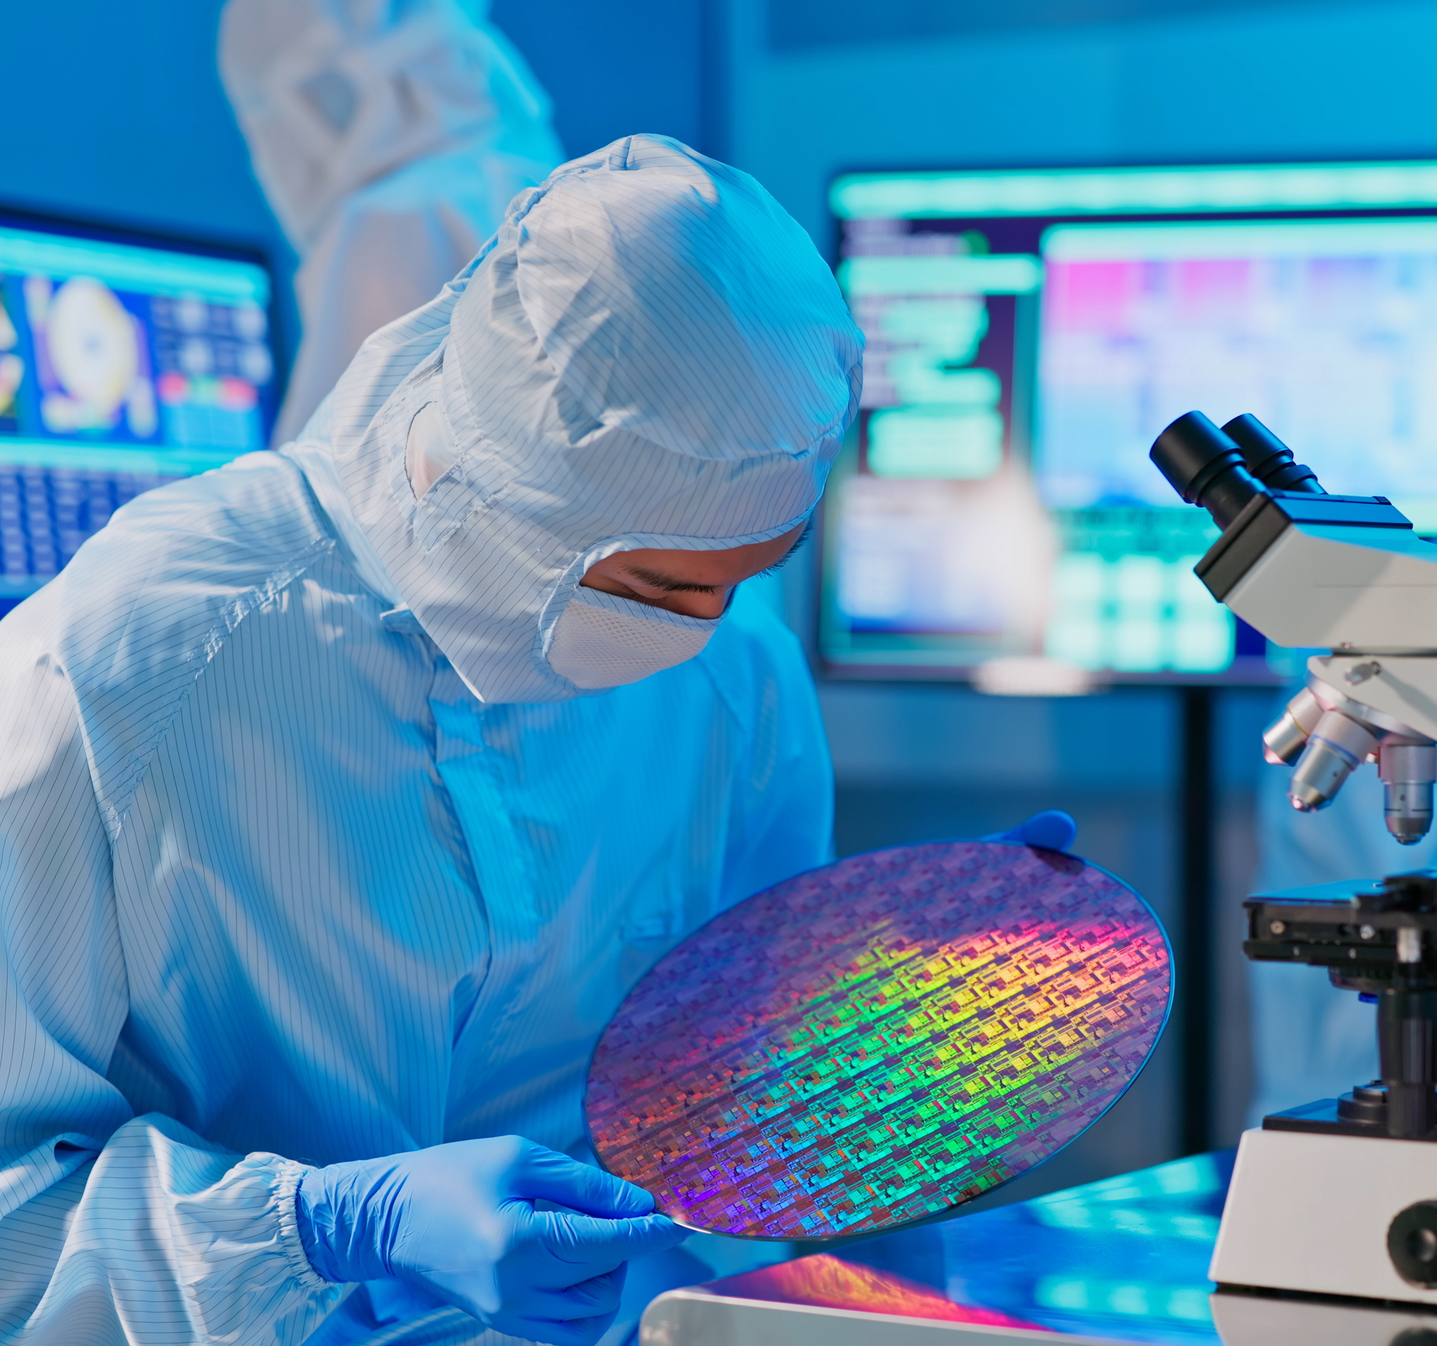

Two-Semester Certificate Grows the Talent Pipeline by:
Preparing people for Entry-Level Technician roles
Embedding Applied Math & Career Exploration
Facilitating structured cohort models with wraparound support
Allowing returning students to take targeted coursework, avoiding lost credits
Preparing people for working in a cleanroom; wearing a “Bunnysuit”
Introducing Chemical and Cleanroom Safety
Introducing the use of Standard Operating Procedures, working from digital checklists
Notes:
Speaker Notes:
As a reminder, these courses are intended to support a two-semester certificate.
Reducing barriers by not having pre-req math/science and embedding content in a contextualized manner
Gives students early experiential learning by getting them into bunny suits early and hands on with tools.
Adaptable lab model allows schools to scale adoption to fit their own institutional resources: Low Tech > High Tech Labs.
Image Sources:
CSCC Adobe Stock License Image: AdobeStock_431031722
Logos: CSCC

Slide 16
Professional Development “Train The Trainer” series
Courses:
Objectives:
Introduction to Manufacturing
Semiconductor 101
Introduction to Vacuum Systems Technology
Review OhioLINK Resources
Provide rationale for topics and/or content level
Share “Lessons Learned”
Discuss “Frequent Student Questions”
Notes:
Speaker Notes:
As a reminder, these courses are intended to support a two-semester certificate.
Reducing barriers by not having pre-req math/science and embedding content in a contextualized manner
Gives students early experiential learning by getting them into bunny suits early and hands on with tools.
Adaptable lab model allows schools to scale adoption to fit their own institutional resources: Low Tech > High Tech Labs.
Image Sources:
CSCC Adobe Stock License Image: AdobeStock_431031722
Logos: CSCC

Slide 17


“Train the Trainer” PD uses a Flipped-Learning Model
Locate Content available @ OhioLINK
Download content you may be interested to teach
Review content designated for review and discussion
Notes:
Speaker Notes:
This professional development experience will be virtual and modeled around the “flipped classroom” approach. Participants will have approximately 2 weeks to begin reviewing content available at OhioLink—as well as 2 weeks between the three virtual sessions.
Each virtual session will be devoted to a group of modules (weeks) of content. The leaders for each session will use a selection of slides representative of the content covered in that virtual session to prompt a rich, meaningful discussion and answer questions or concerns.
______________________________________________________
Image Sources:
CSCC Adobe Stock License Image: AdobeStock_396959712

Slide 18
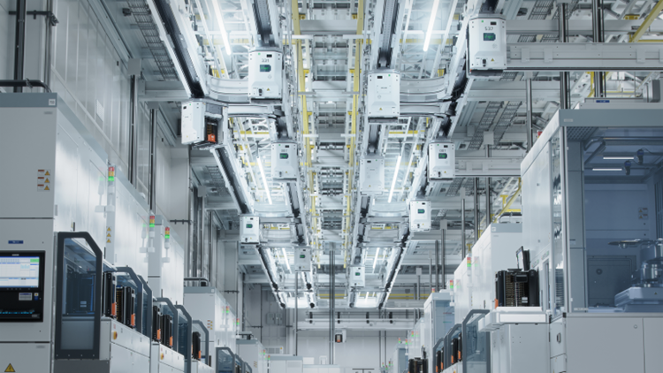
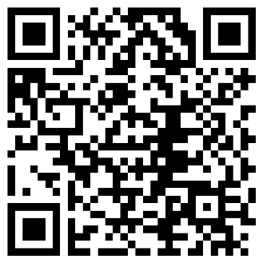

OSCN Educator Preparation | “Train the Trainer”
Registration QR Code
Introduction to Manufacturing, FRIDAYS: 10:00 AM – 11:00 AM
WEBINARS: April 4, 2025  April 11, 2025  April 18, 2025
Registration Link https://forms.office.com/r/WiH5QQ1DQr?origin=lprLink

Slide 19

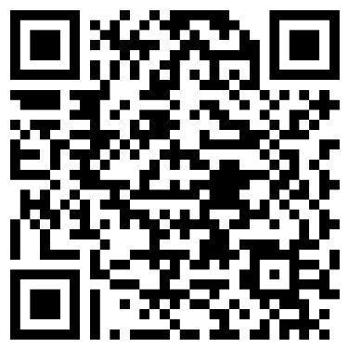
OSCN Educator Preparation | “Train the Trainer”
Registration QR Code
Semiconductor 101, FRIDAY SESSIONS
MERIT 1-Day Experiential Tour, 10 AM-3 PM with lunch: Lorain County Community College campus, March 28, 2025 THREE WEBINARS, 3-4 PM: April 4, 2025  April 11, 2025  April 18, 2025
Registration Link https://forms.office.com/r/D2i3U8B8Q6?origin=lprLink

Slide 20


MERIT | LCCC, 1-Day Cleanroom Event
FRIDAY, March 28, 2025 START TIME: 10:00 AM END TIME: 3:00 PM Working Lunch is included
LOCATION: Lorain County Community College The Richard Desich Business & Entrepreneurship Center (DEC) 151 Innovation Drive | Elyria, Ohio 44035
Notes:
Speaker Notes:
Here is a reminder for the optional, MERIT 1-day Cleanroom event. If you would like to attend, please pop your fullname and email in the chat with a “MERIT+YES” or “Attending MERIT.”
Image Sources:
Logos: OSCN, LCCC (MERIT)

Slide 21
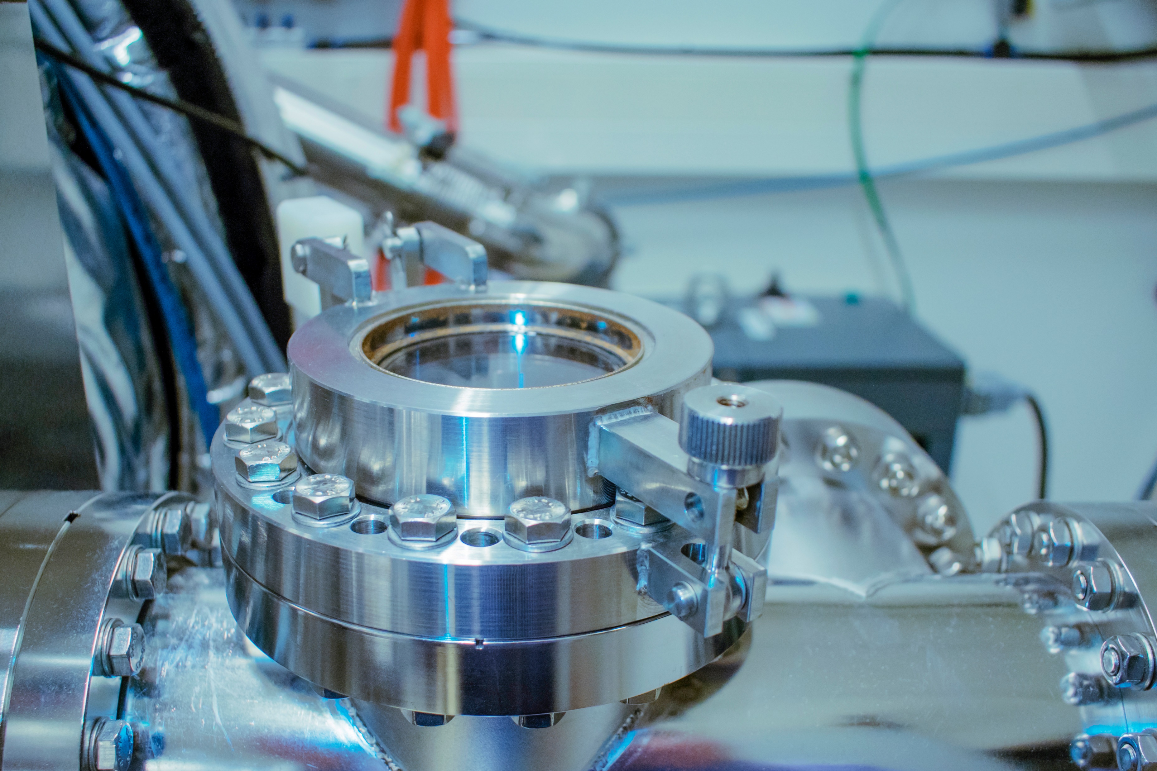
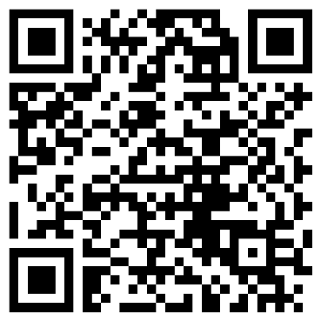
OSCN Educator Preparation | “Train the Trainer”
Registration QR Code
Introduction to Vacuum Systems Technology, FRIDAY SESSIONS
TWO WEBINARS, 11:30 AM - 1 PM: April 11, 2025  April 18, 2025 TWO In-Person Sessions, 9 AM-3:30 PM with lunch: Columbus State Community College campus April 25, 2025  May 2, 2025
Registration Link https://forms.office.com/r/W5r57QT9Ji?origin=lprLink

Slide 22


Future Technicians Learning Community
"Connecting Students with Industry for Career Growth"
The Future Technicians Learning Community is a space for students in technical programs to connect with employers, gain industry insights, and develop career-ready skills.
Through networking, coaching, and learning opportunities, we help bridge the gap between education and the workforce.
DOL SCC4 grant supported
Notes:
Speaker Notes:
Future Technicians Learning Community
"Connecting Students with Industry for Career Growth"
The Future Technicians Learning Community is a space for students in technical programs to connect with employers, gain industry insights, and develop career-ready skills. Through networking, mentorship, and learning opportunities, we help bridge the gap between education and the workforce.
Image Support:
CSCC logo

Slide 23


FTLC Employer Engagement Goals
Our Goal:
Facilitate employer participation once a month (excluding breaks & holidays) to provide students with industry insights and hands-on experiences.
Ways to Get Involved:
Info Sessions & Webinars: Share insights on roles, responsibilities, and job requirements.
Guest Speaking Opportunities: Present on industry trends or career paths.
Facility Tours: Give students a behind-the-scenes look at your workplace.
LinkedIn FTLC (private) Group: Provide industry info, job postings and career / professional advice
In partnership with OACC and the Central Ohio Manufacturing Partnership (ISP)

Slide 24
Columbus State Annual Events
Engineering Technology Day
Audience: Prospective Adult Learners interested in Engineering Tech programs
Wed, Apr 9 | 4:30PM-6:30PM | Mitchell Hall
Tue, Oct 10 | 9AM-12:30PM & 4:30PM-6:30PM | Workforce Development Building
An open-house with info sessions, a CSCC resource fair, and a panel with employers, graduates, and students
CState Technation Day
Audience: High School students (morning) & adult learners (evening)
An interactive event featuring hands-on activities, lab tours, a resource fair with employer partners and/or guest speaker breakout sessions

Slide 25
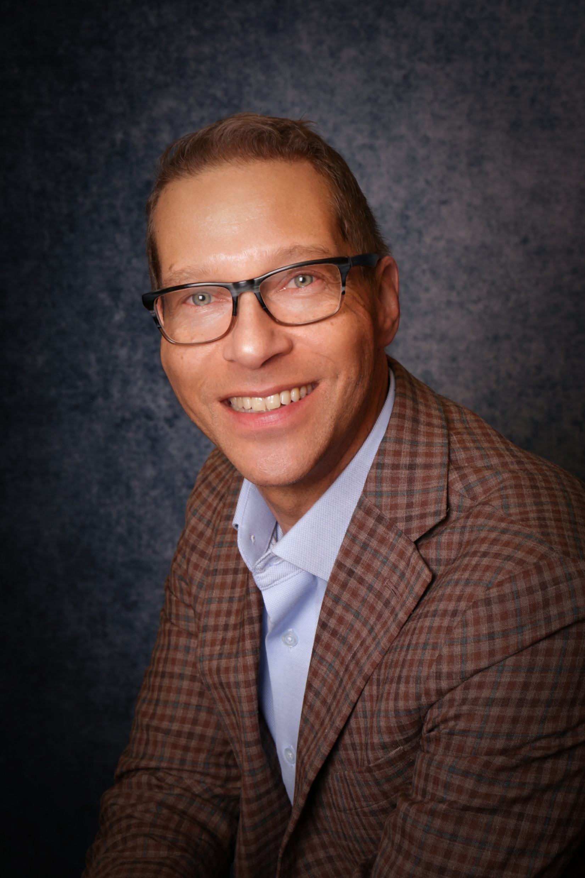
If you have questions regarding:
OSCN PD “Train The Trainer” series
CSCC Future Technicians Learning Community
Scot McLemore
smclemore3@cscc.edu

Slide 26


Early Successes of FlexFactor at Zane State College
Tracey Porter, Dean of Workforce Development March 18, 2025

Slide 27
Secret sauce?
Leader on Campus who is a
FlexFactor Champion
Dedicated Staff
Relationships
Funding

Slide 28
Dedicated Program Manager
- Hired: August 5, 2024
- Role: Oversees program implementation, builds relationships with schools and businesses, and delivers in the classroom.
- Impact: Provides structure, consistency, and direct support for schools and students

Slide 29
Student Engagement & Iterations
- Bridgeport Schools: 4 iterations, 47 students
- Buckeye Trail School: 2 iterations, 50 students
- Zanesville High School: 5 iterations, 92 students
- Total Impact: 11 iterations, 189 students engaged

Slide 30
Key Success Indicator - Outreach Events
- Attended local Business Advisory Council meetings
- Engaged in STEM-focused events like the Appalachian STEM Collaborative meetings
- Built partnerships with Career Navigators at schools

Slide 31
Overcoming Engagement Barriers
- Some schools were historically tough to engage
- Key strategy: Working with career-focused teachers
- Demonstrated how FlexFactor enhances curriculum and lightens teachers’ workload

Slide 32
Connecting Students to Pathways
- Core component of FlexFactor: Helping students see STEM career pathways
- Emphasized real-world application and career connections
- Building excitement and awareness among students

Slide 33
Celebrating Early Success - April 11 Event
- Campus Tour & STEM Combine Activities:
- Disc Golf Demonstration
- Drone Demonstration
- Chemistry Demonstration
- Energy Bike (linked to engineering programs)
- Cybersecurity Demonstration
- Health Program Demonstration
- Wrap-Up: Industry Panel Discussion:
- Invited Guests: Intel (not confirmed), Manufacturer, Local Hospital, NextFlex Representative
- Topics: Early education decisions, broad STEM career opportunities, panelists’ “moment when” stories

Slide 34
Q&A
Thank You!
Tracey Porter, Dean of Workforce Development
tporter2@zanestate.edu
Robin Carroll, FlexFactor and Career Coordinator
rcarroll@zanestate.edu

Slide 35
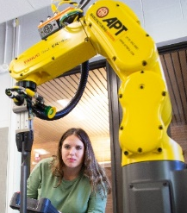
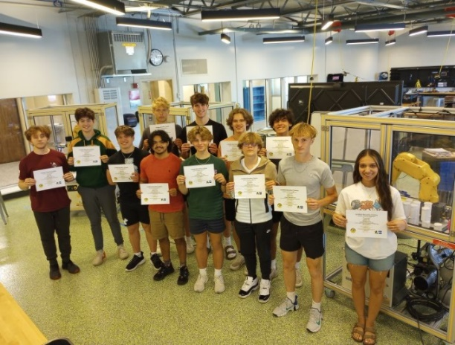
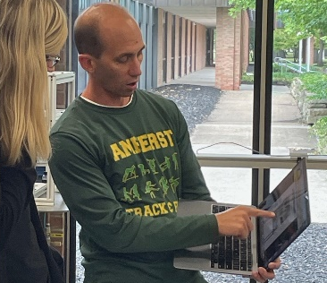

Industry 4.0 Teacher Training
For more information, please review our website:
https://www.lorainccc.edu/engineering/industry-4-0-teacher-training/
Automation and Robotics
Programs Include:
**NEW** Future-Ready Educator Bootcamp: Exploring Industry 4.0
Introduction to Industry 4.0 for Educators (Virtual)
Introduction to Robotic Programming using CoderZ (Virtual)
Introduction to Automation and Robotics (In-Person)
Teacher Training Success:
Two bootcamps held in August and January
Partnered with Sinclair for the January bootcamp for the online portion
Six (6) teachers have taken advantage of the Graduate Credit offered with Ashland University
Certificate Program Success:
Certification program was filled and interest in next year
Having the option to take one pathway at a time was helpful; about half of the participants are only taking one pathway
Majority of participants are from Career Technical Centers, and all are in the K-12 space
Challenge: Finding dates that work for K-12 population
Facilitator Trainings:
Introduction to Introduction to Robotics for Educators
Introduction to Programmable Logic Controllers (PLCs) for Educators
Both Programs include:
Hands-on, Industry-Relevant Projects
Industry-Recognized Credentials
Capstone Course
Build Your Industry Network
Recruitment Success:
Relationships, Relationships, Relationships
Notes:
Would you be available to share an update on the automation bootcamp and teacher training that you’ve held and the most recent on that you recruited for and filled?
Boot camps were held in August and January. Several participants in January were those who could not attend in August. We joined forces with Sinclair for our January BootCamp to utilize the online portion and offer multiple options for the in-person hands-on. The model was successful, but more work needs to be done to find dates that work for the K-12 population. January did not fill, but we did have a lot of interest. We currently do not have another BootCamp planned. Six teachers have taken advantage of the Graduate Credit Offered with the bootcamp.
Could you share an overview of the programs but also the successes you had in recruitment, who was recruited, how you recruited, any feedback you received, and lessons learned?
Our Certification program filled this year, and we actually have quite a bit of interest for next year as well. Having the option to take one pathway at a time has proved fruitful, as about half of our participants are only taking one pathway. The majority of our participants are from Career Technical Centers, and all are in the K-12 space.
Recruiting is definitely about relationships. The majority of this year's and next year's cohorts' interested parties came from working closely with Rockwell and IST (FANUC). The other change we are noticing is that schools are sending more than one person. Several schools in our pipeline have had others who filled the role in their districts and then left or retired. Schools are finding it is better to have several people trained to make them more agile. The biggest lesson learned is to really work on your partnerships and don't rely on newsletters and collateral. It is also important to recruit and inform all year long. This is helpful for schools' budgeting cycle and utilizing grants. Also, it often takes time for a program to start from scratch and find the right instructors who can take the time to participate.

Slide 36
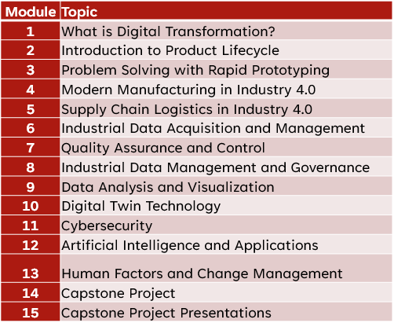
Digital Transformation and Advanced Manufacturing
Goal: Expand talent pipelines to meet critical workforce needs in advanced manufacturing and technology.
Foundations in Digital Transformation
Comprehensive Digital Transformation curriculum
Aligned with the Ohio Manufacturing Competency Model
Curriculum Replication: OU, CSU, Piqua High School

Slide 37
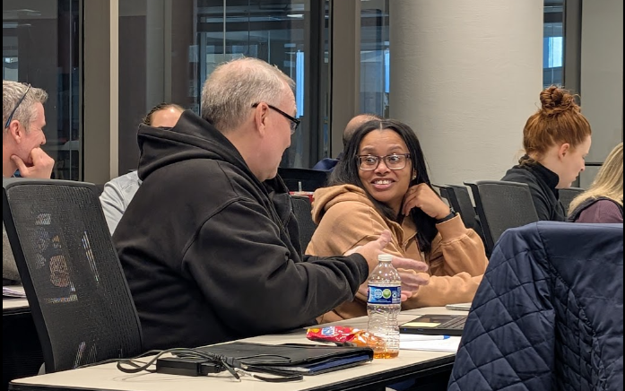
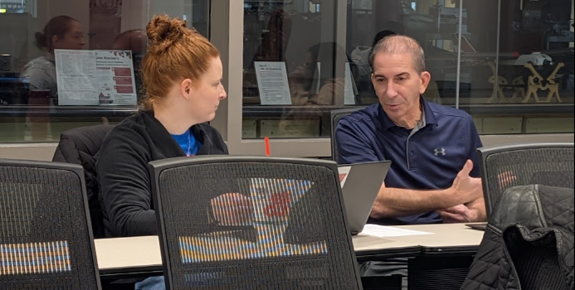
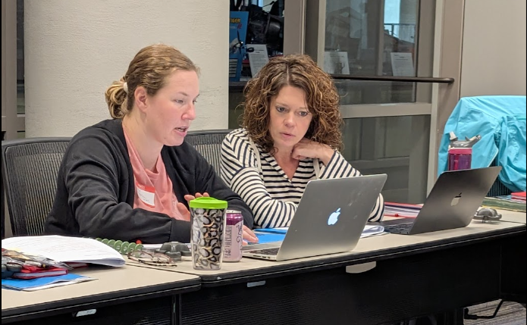
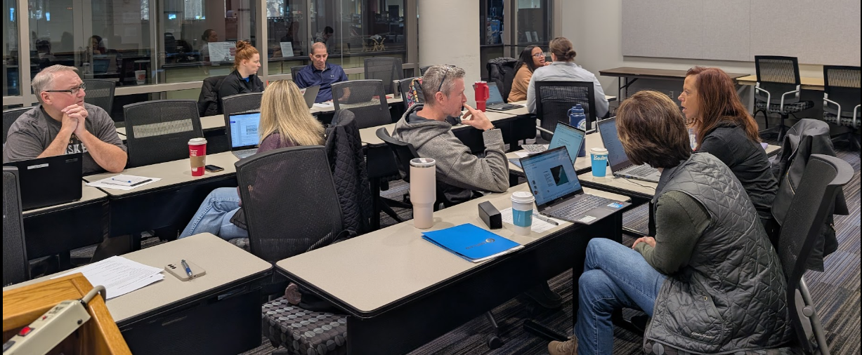
Professional Development for the Future of Education
Train-the-Trainer Workshops
Equip educators with practical strategies and industry-aligned insights, bringing new technologies and concepts to the classroom
Utilize Foundations in Digital Transformation curriculum
Session 1: 11 educators participated
Session 2: 8 educators participated
Lesson implementation
AI, 3D printing, CAD
Session 1: 11 participants
Session 2: 8 participants

Slide 38
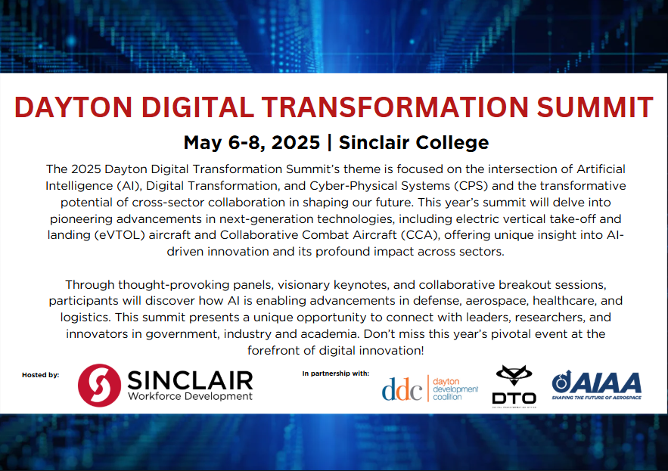
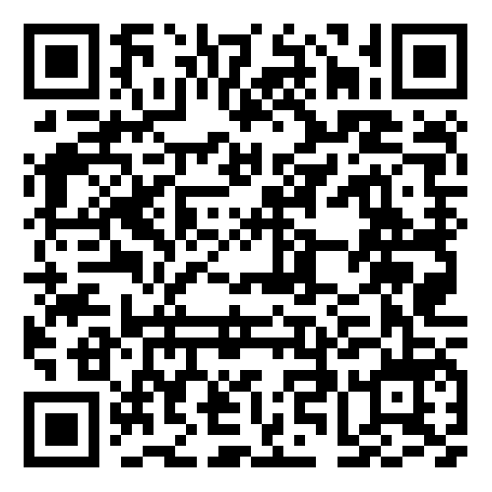
Dayton Digital Transformation Summit
Registration:

Slide 39
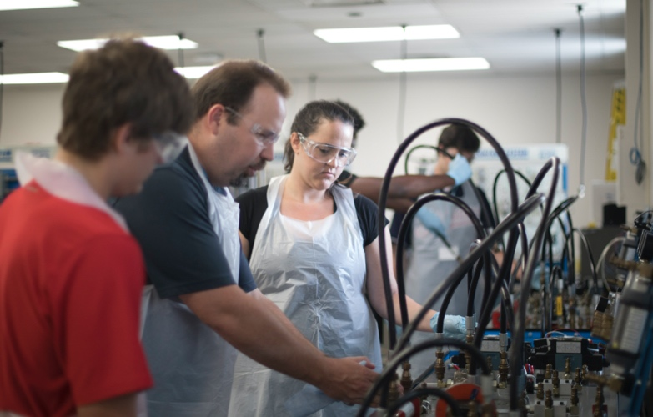

Partners in Training Ohio’s Manufacturing Workforce
Thank you to all the presenters today!
April OTN Meeting April 15, 2025 at 8:30am

