Slide 1
Ohio Technical Skills Innovation Network
Ohio TechNet Monthly Meeting
JUNE 2025
Date: June 17, 2025
www.ohiotechnet.org

Slide 2
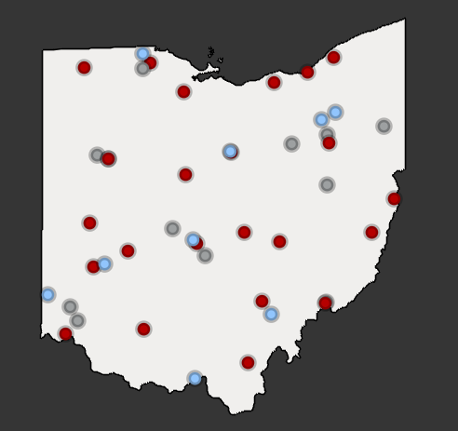
Vision
Partners in Training Ohio’s Manufacturing Workforce
The members of the Ohio Technical Skills Innovation Network, or Ohio TechNet, are nationally recognized for partnering with industry to implement collaborative, innovative solutions that meet manufacturing and tech workforce needs.
Mission
Ohio TechNet supports workforce development and academic professionals to incubate, develop and sustain programming that accelerates the growth of Ohio’s manufacturing & technical workforce.
OTN Members:
Community College Technical Center University
Purpose
Ohio TechNet partners benefit from peer-to-peer collaboration, technical assistance and access to resources, making program expansion and innovation at their institution more efficient, faster to implement and easier to sustain.

Slide 3
Strategic Focus Areas
Guided Pathways for Youth
Reaching New Audiences
Innovative Earn and Learn
Faculty and Educator Development
Ohio TechNet’s strategic focus areas provide partners with best practices, models, and technical assistance to address the critical workforce needs in the state
Partnering with Industry

Slide 4
MORNING WARM UP

Slide 5
Microcredential in Microgrids, Nancy Pratt of Cleveland State University
OTN Updates
Smart Mfg and Engineering Tech Resources
Guided Pathways for Youth
Intel SERP Project
ITAC Internship and Roadmapping Process
Northshore Manufacturing Workforce Partnership
OACC Community of Practice
OACTE Ohio TechNet Breakout Session
OTN Open Discussion
What is your institution hiring for?
What new grants and projects has your institution started?
Share your institution's best practices, current needs, and/or ideas for collaboration
Please share any content to be included in OTN's newsletters and/or your interest in presenting at an upcoming OTN Meeting

Slide 6
Powering the Future: Microgrids Microcredential
Stackable Microcredential in Distributive Energy
Nancy M. Pratt, Ph.D. Executive Director Division of Continuing and Extended Education Cleveland State University n.pratt@csuohio.edu 216-577-2766

Slide 7
How CSU Defines the Microcredential?
At Cleveland State University, a microcredential is a rigorous, workforce-focused learning experience that meets the following criteria:
Collaboratively Developed Created in partnership with CSU faculty and industry experts to ensure relevance and real-world applicability.
Competency-Based and Industry-Aligned Built around measurable learning outcomes and skills that reflect current and emerging workforce needs.
Workforce-Oriented and Stackable Designed to offer a clear path to employment, advancement, or further learning, whether through certifications, licensure, or stackable academic credit toward a degree.

Slide 8
The Microcredential in Microgrid Systems is planned as a three-part stackable credential. It begins with a six-week Foundations 1 course.
Foundations 1 prepares individuals for the INCOSE ASEP certification exam, a globally recognized credential that strengthens professional credibility in systems engineering and the energy sector.
Prerequisites include (one of the three):
Completion of undergraduate engineering coursework at a Junior level
Completion of a technical Associate Degree from an accredited community college
Equivalent experience of 5 years in a technical capacity in the industry, with an energy focus
Development partners:|
Telepath Systems, Inc.
The International Council on Systems Engineering (INCOSE)
The Cleveland Engineering Society (CES)

Slide 9
Microgrids Systems Foundation 1 certificate helps participants build critical expertise in sustainable energy systems, supporting knowledge acquisition in two key area blocks:
BLOCK 1: This section provides a basic understanding of electricity and its application to modern society's needs, including its origins and history of evolution to modern grid architectures and microgrid forms.
BLOCK 2: Introduces systems theory, principles, and methods, with a special focus on their applicability to Microgrids through modeling and simulation capabilities.
Upon completing this Certificate, students will be eligible to apply for the INCOSE Associate Systems Engineering Professional (ASEP) certification, which provides a dual certification opportunity.

Slide 10
Meeting the Workforce Gap Without Competing with Technical Training
CSU designed Foundations 1: Microgrids at a systems-level to avoid duplicating or competing with technician-level workforce training already offered.
Our goal:
Fill a labor gap in the non-engineer, non-technician segment professionals who need to understand and work with microgrid systems, but not necessarily install or maintain them.
Support decision-makers across energy, infrastructure, sustainability, facilities, and policy roles who must evaluate, advocate for, or manage microgrid implementation.
Prepare mid-level professionals to engage with emerging energy technologies through strategic, interdisciplinary, and applied learning, not entry-level technical skills.

Slide 11
Cost: $1540 Standard Registration
One industry partner scholarship available per cohort.
Upcoming Course Dates: Synchronous, Online: July 11, 18, 25; August 1 and 8 In-person Lab Day, August 15 from 1-5 p.m.

Slide 12
In development for a late 2025 launch and 2026 launch:
Credential 2: Advanced Microgrid Systems and Integration
Credential 3: Energy Policy, Finance, and Infrastructure Strategy
Thank you!

Slide 13
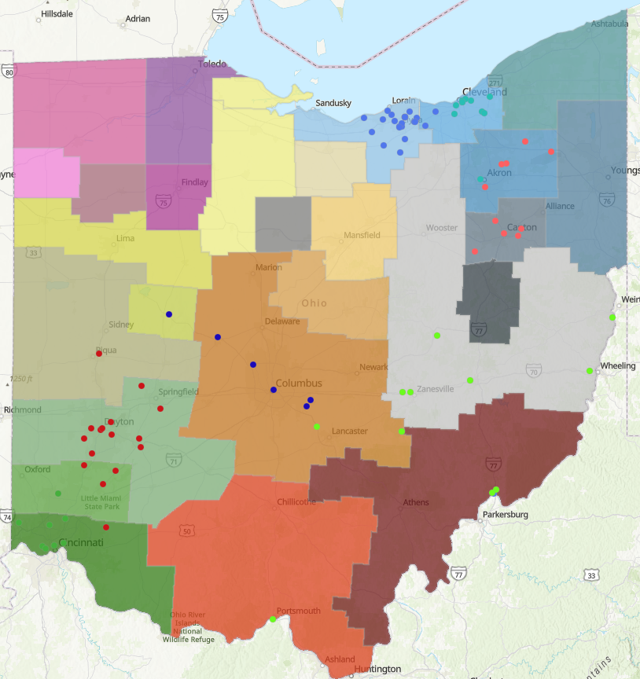
Smart Manufacturing Asset Map
Update of an Automation & Robotics asset map from 2020, incorporating state-level data and priorities
Collaboration with OMA, Ohio MEP, ODHE, ODEW
Technical Calculus for Engineering Technology
Built based on OSU's Technician Calculus course for BS in Engineering Technology
Proposed course will serve as a 3rd tier of technical mathematics for programs in Advanced Manufacturing and Engineering Technology
Learning Outcomes have been circulated for feedback and endorsement to faculty across the state, PD to be scheduled
PARTNERING WITH INDUSTRY
FACULTY & EDUCATOR DEVELOPMENT

Slide 14
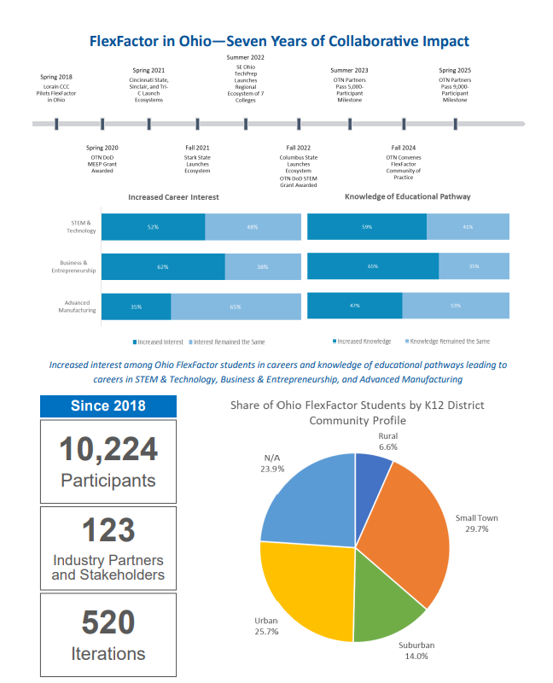
OTN FlexFactor Community of Practice
Statewide impact report
In Spring 2025 partners collectively surpassed the 10,000 student milestone
Statewide K-12 Alignment Strategy
Catalog/mapping of K-12 manufacturing technology/STEM programs and assets
Emerging toolkit for educators, industry, and stakeholders to build awareness of available assets, and how they align to state standards
GUIDED PATHWAYS FOR YOUTH

Slide 15
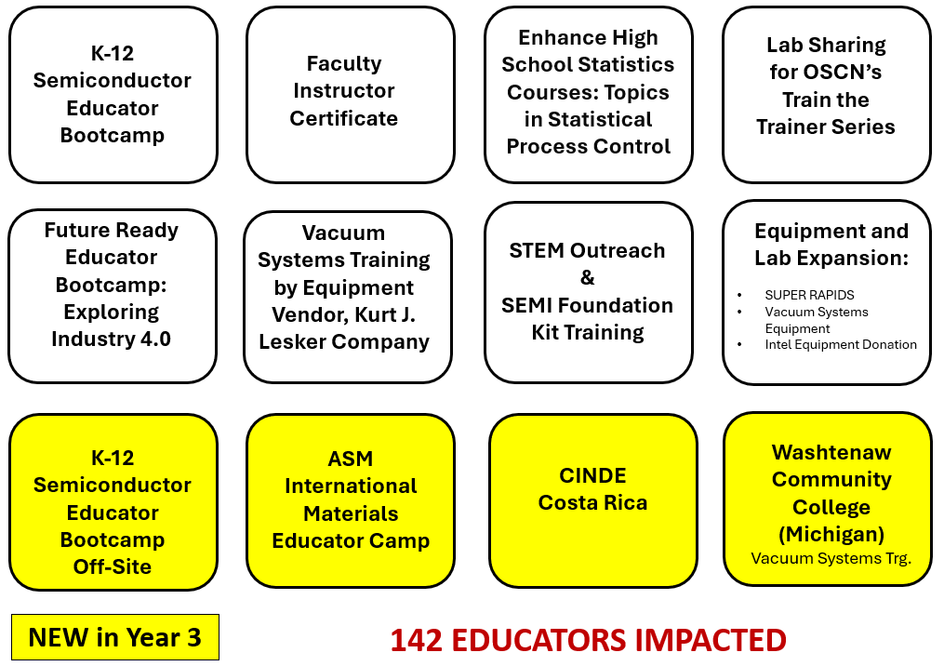
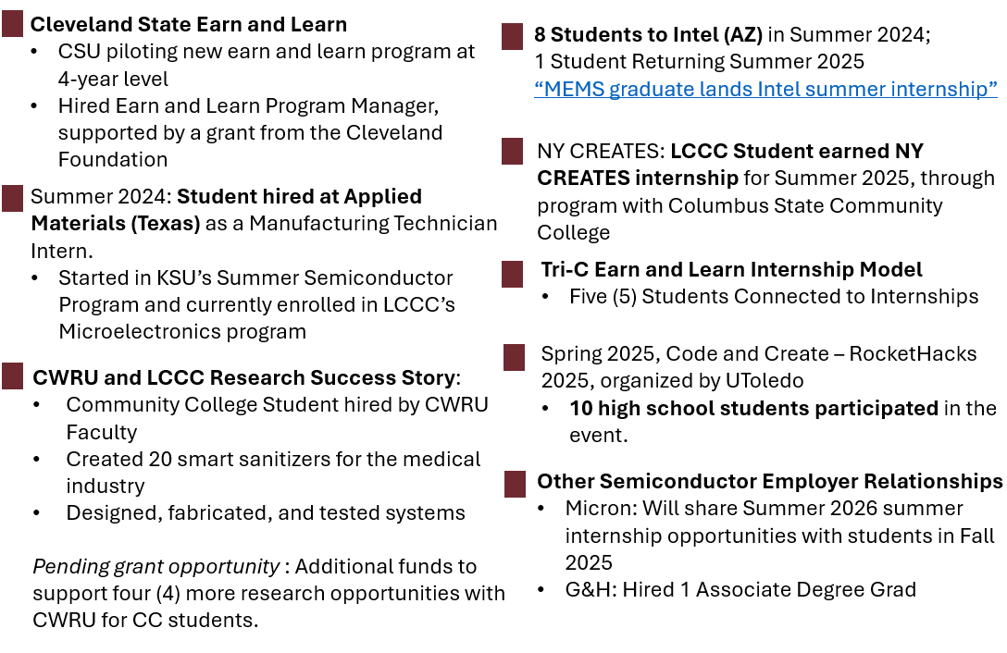
Intel SERP
Curriculum Development & Integration
Faculty Development
Experiential Learning
7 Modified Classes
12 Developed Classes
3 Modules/Microcredentials Created
7 Certificates Modified/Developed
3 Associate Degrees Modified
4 Bachelor Degree Pathways Modified
Enrollment Impact: 441 Students

Slide 16
DOE Industrial Training & Assessment Centers (ITAC) Implementation Grant
Reaching New Audiences
Partnering with Industry
Innovative Earn and Learn
Smart Manufacturing Roadmapping Assistance & Talent Planning
ITAC Internships: Interns to support smart manufacturing roadmapping and talent planning services
Career Readiness & Career Training
Goal: 290 Total Participants Served
Goal: 30 Total SMMs provided technical assistance (15 Roadmapping & 15 Talent Planning)
Goal: 15 Total ITAC Interns Hired

Slide 17
Northshore Manufacturing Workforce Partnership Supporting Community Colleges, Round 5
Sector Convener & ISP Engagement
Serve as the lead convener of the manufacturing industry and support engagement of ISPs
Help guide employer engagement strategy with partners
Inform statewide alignment to the Ohio Manufacturing Competency Model
Provide technical assistance to educators and ISPs
Support program enhancement design and job placement activities via industry engagement efforts to identify participant opportunity
Advise on incumbent worker recruitment to earn-and-learn programs
College Partners
Serve 875 participants, with targets for earn-and-learn
Support regional collaboration and scale partnerships with Local Area Workforce Development and ISPs
Collaborate with worker-focused organizations to ensure worker voice
Enhance articulation and transfer agreements in partnership with OACC
Enhance and expand wraparound supports in collaboration with industry and workforce partners
Industry Sector Partners
Convene industry employers and educational / workforce partners to inform on in-demand talent needs and interest in partnering
Support expansion of earn-and-learn opportunities for participants
Inform and support industry engagement that opens employment opportunity for participants
Inform academic programs and noncredit to credit pathways
Gather feedback from employers on program outcomes
Credit Articulation and PLA
Convene faculty panels
Support curriculum alignment with Ohio Manufacturing Competency Model and alignment with other statewide manufacturing efforts
Articulation and transfer update planning (career technical and engineering tech pathways)
Implementation and enhancement of non-credit to credit articulation

Slide 18
OACC Advanced Manufacturing Education Stakeholder Summit
July 8th, 2025: 10am to 2pm
Ohio Chamber of Commerce Building
This initiative—led by the Ohio Association of Community Colleges (OACC) and the Ohio Department of Higher Education (ODHE)—bringing together faculty, industry experts, and education leaders to redevelop two cornerstone courses: Introduction to Manufacturing and Introduction to Semiconductors to align with industry needs.
Registration Link: https://oaccsuccesscenter.regfox.com/enhancing-the-engineering-technology-curriculum-aligning-omi001-introduction-to-manufacturing-and-ose001-introduction-to-semiconductors-with-oma-competencies-for-a-common-certificate-pathway
Upcoming Presentations & Training
OACTE Conference: Ohio TechNet Breakout Session
Peter Jensen, Program Developer with Ohio TechNet (OTN), Jessica Short, Chief of Operations with DO STEM and Brett Doudican, Curriculum Supervisor at Greene County Career Center will be co-presenting at the upcoming Ohio ACTE Conference, held July 21–23, 2025 in Columbus, Ohio!
Their session, “Work Smarter, Not Harder: Connecting with the Network of Networks to Accelerate Innovation” will highlight how cross-sector collaboration is driving workforce innovation and accelerating impact across Ohio.
For more information, visit: Ohio Association for Career and Technical Education
Notes:
https://oaccsuccesscenter.regfox.com/enhancing-the-engineering-technology-curriculum-aligning-omi001-introduction-to-manufacturing-and-ose001-introduction-to-semiconductors-with-oma-competencies-for-a-common-certificate-pathway

Slide 19
What is your institution hiring for?
What new grants and projects has your institution started?
Share your institution's best practices, current needs, and/or ideas for collaboration
Please share any content to be included in OTN's newsletters and/or your interest in presenting at an upcoming OTN Meeting
Open Discussion
Notes:
https://oaccsuccesscenter.regfox.com/enhancing-the-engineering-technology-curriculum-aligning-omi001-introduction-to-manufacturing-and-ose001-introduction-to-semiconductors-with-oma-competencies-for-a-common-certificate-pathway

Slide 20
Partners in Training Ohio’s Manufacturing Workforce
NEXT MEETING:
July OTN Meeting July 15, 2025 at 8:30am
FOLLOW OHIO TECHNET ON LINKEDIN!

