Slide 1














Ohio Technical Skills Innovation Network
Ohio TechNet Monthly Meeting
APRIL 2025
Date: April 15, 2025
www.ohiotechnet.org

Slide 2


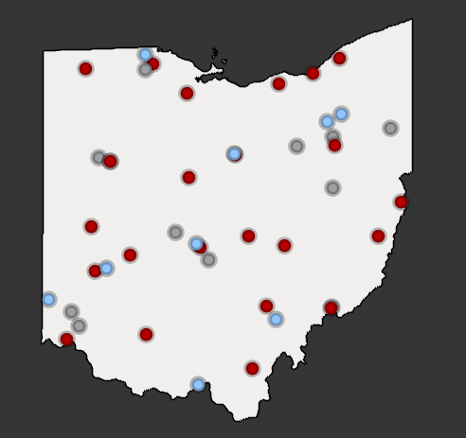


Vision
Partners in Training Ohio’s Manufacturing Workforce
The members of the Ohio Technical Skills Innovation Network, or Ohio TechNet, are nationally recognized for partnering with industry to implement collaborative, innovative solutions that meet manufacturing and tech workforce needs.
Mission
Ohio TechNet supports workforce development and academic professionals to incubate, develop and sustain programming that accelerates the growth of Ohio’s manufacturing & technical workforce.
OTN Members:
Community College
Technical Center
University
Purpose
Ohio TechNet partners benefit from peer-to-peer collaboration, technical assistance and access to resources, making program expansion and innovation at their institution more efficient, faster to implement and easier to sustain.

Slide 3
Strategic Focus
Areas
Guided Pathways for Youth
Reaching New Audiences
Innovative Earn and Learn
Faculty and Educator Development
Ohio TechNet’s strategic focus areas provide partners with best practices, models, and technical assistance to address the critical workforce needs in the state
Partnering with Industry

Slide 4

MORNING
ICEBREAKER

Slide 5

FOLLOW
OHIO TECHNET
ON LINKEDIN!
Notes:
https://www.linkedin.com/company/ohio-technet/?viewAsMember=true

Slide 6

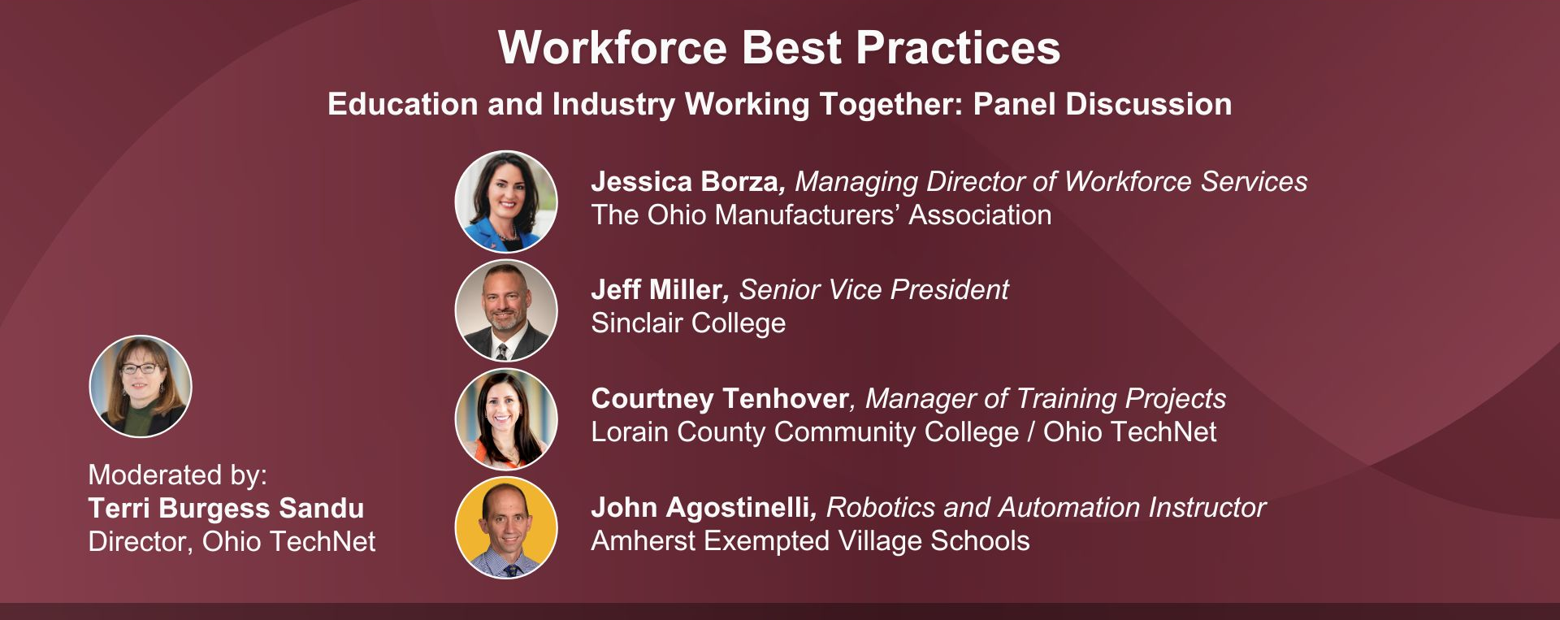
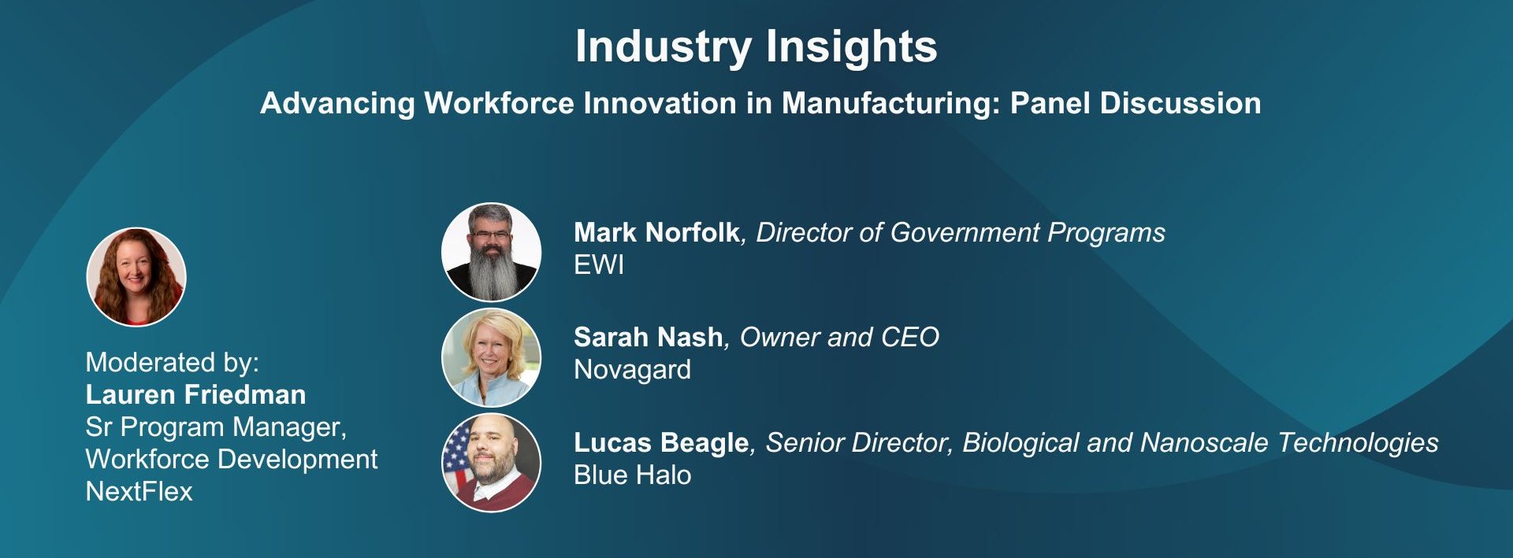


Innovating, Investing, and Leading Development of the Defense Industrial Base Event
Wednesday, April 30th, 2025 | 9:30am – 2:00pm
Have Resources to Share? We invite you to contribute handouts, announcements, and updates that you believe would be valuable for our event attendees.
Notes:
https://www.lorainccc.edu/about/innovating-investing-leading-for-the-defense-industrial-base/

Slide 7

Join OTN Partners at the Guardians Game
Tuesday, April 29th, 2025 | 6:10 PM
Ohio TechNet invites you to an exciting evening of networking, baseball, and camaraderie.
Purchase your ticket in advance and meet us at the game!
Let us know you're coming here so we can plan accordingly.
📅 Date: Tuesday, April 29, 2025, at 6:10 PM
📍 Location: Progressive Field, Cleveland
🎟 Tickets: $20 (including fees) – Pay Your Own
🎫 Ticket Type: Standing-Room Only District Ticket - The Corner Bar
Notes:
https://app.smartsheet.com/b/form/046a9b4fc61e46338b4da857afb6dd58

Slide 8



METAL Bootcamp for Educators at The Ohio State University - Ohio will be the 3rd location to run this bootcamp nationwide!
Technical assistance on the importance of records management with federal grants
Northshore Manufacturing Workforce Partnership, supported by a DOL Strengthening Community Colleges Round 5 (SCC5) investment
Partner Updates – We want to hear from you! Share your recent successes, new projects, or any challenges you're facing. Let's Collaborate!

Slide 9
CDME and METAL

Slide 10

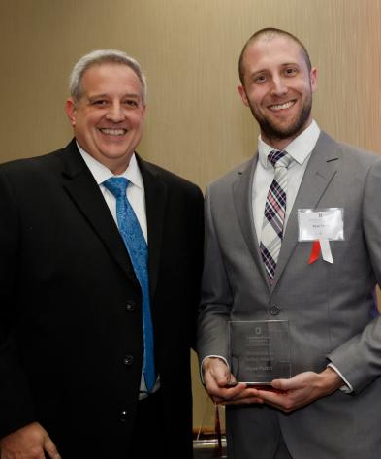
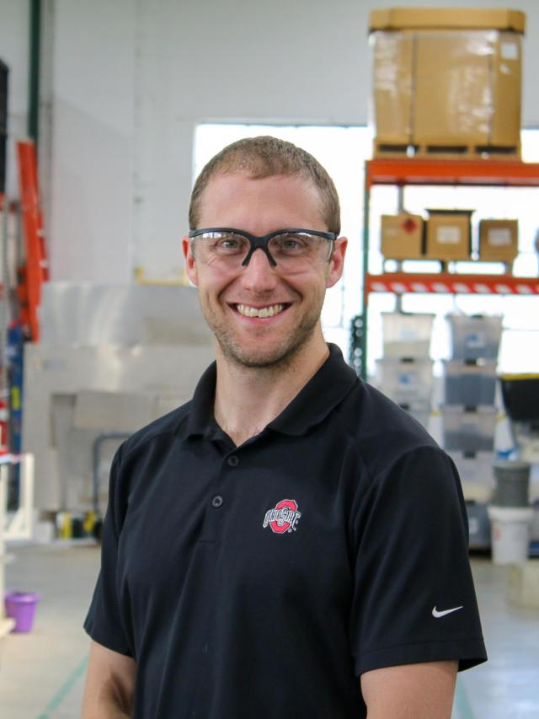
Ryan Petitti
BS Mechanical Engineering, MA Workforce Development and Education
High School Instructor – Tolles Career and Technical Center
Adjunct Professor – CSCC and Clark State College
Application, Combustion, Design Engineer
Plant Manager
Director of MELD @ CDME

Slide 11
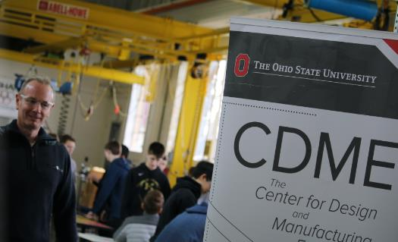
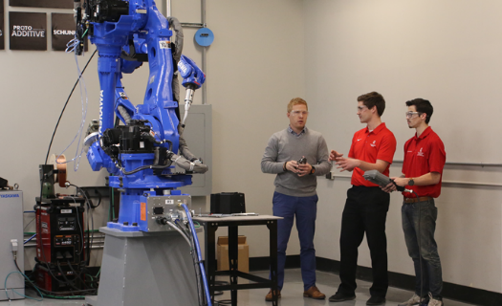
CDME in a Nutshell
Applied Research and Engineering Center with a Mission of Advancing the Manufacturing Competitiveness of the United States
CDME ‘Feels’ like a Manufacturing Environment
- Multidisciplinary Project Teams
- Timeline and Deliverable Driven
- Apprentice-Style Mentorship
~30 Research Staff, 8 Administrative Staff
~150 Undergraduate Research Assistants,
> 250 Affiliated Faculty and Graduate Student
47,000-ft² ITAR and HIPPA Compliant Facilities

Slide 12
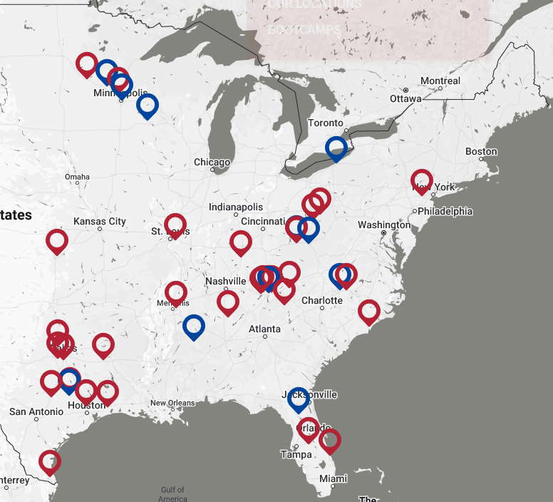
What is ACE
Created in 2020 by the Institute for Advanced Composites Manufacturing Innovation (IACMI)
“A lack of investment in machine tool innovation in the U.S. has left domestic manufacturers turning to more cutting-edge, foreign-built products”
6 hours of online content and 32 hour in person boot camp running equipment
Completely free to the participant

Slide 13
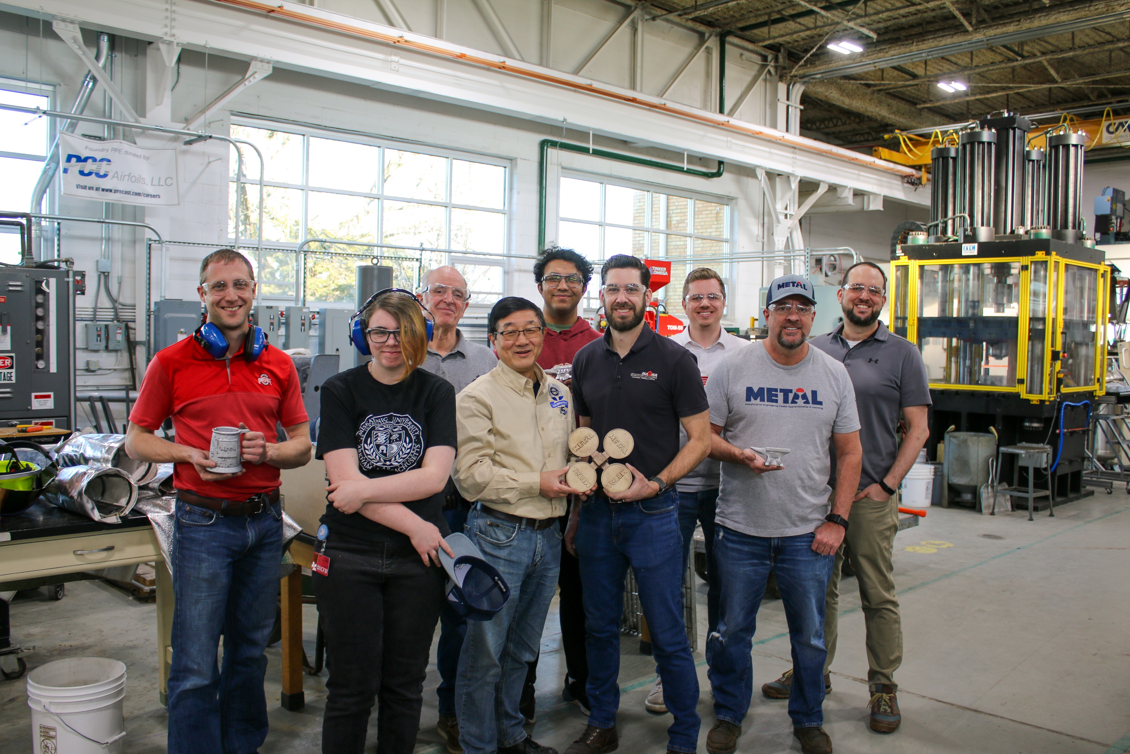
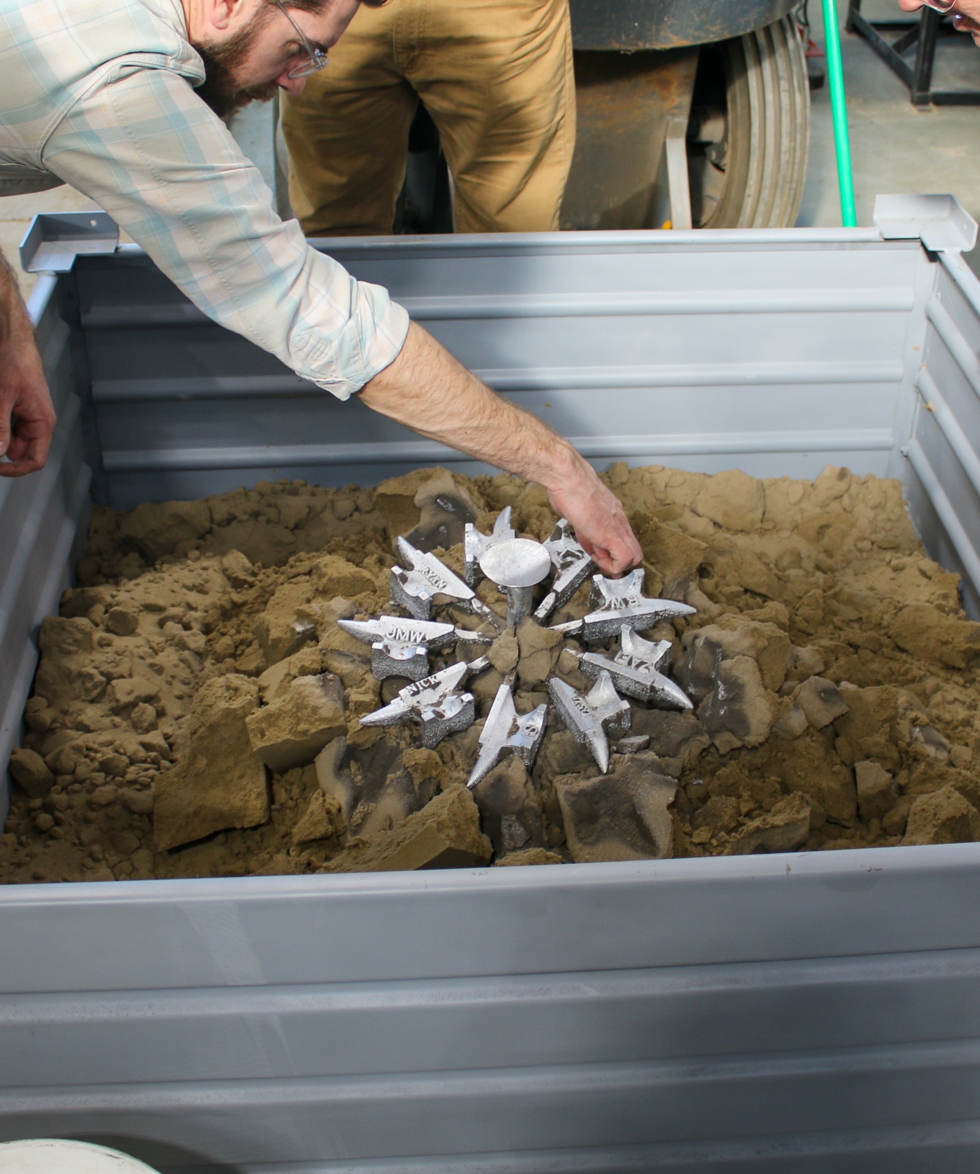
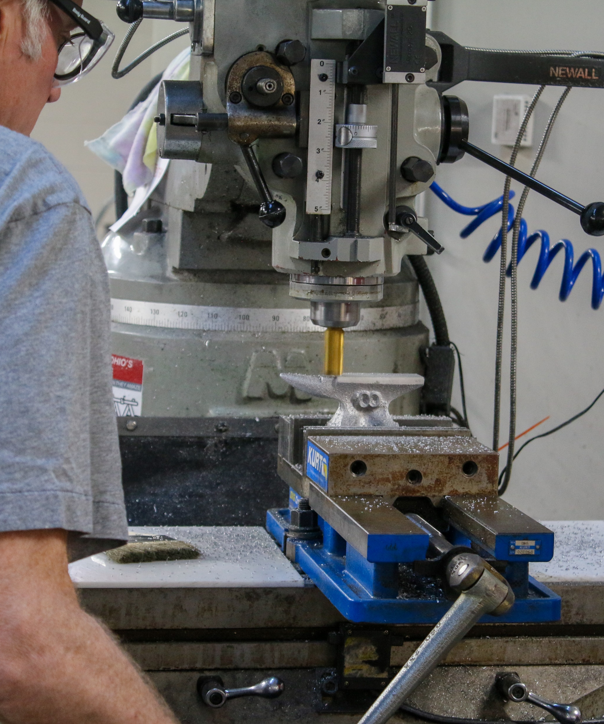
What is METAL?
Created in 2024 by the Institute for Advanced Composites Manufacturing Innovation (IACMI)
“The shrinking supply chain for critical defense materials demands an immediate response. We must rebuild a modern workforce, technologically adept and capable of meeting the demands of our defense industry with efficiency and innovation”
8 hours of online content and 32 hour in person boot camp running equipment
Also offer K-12 workshops
Completely free to the participant
Notes:
Only offered at Penn State, Ohio State, and University of Tennessee

Slide 14
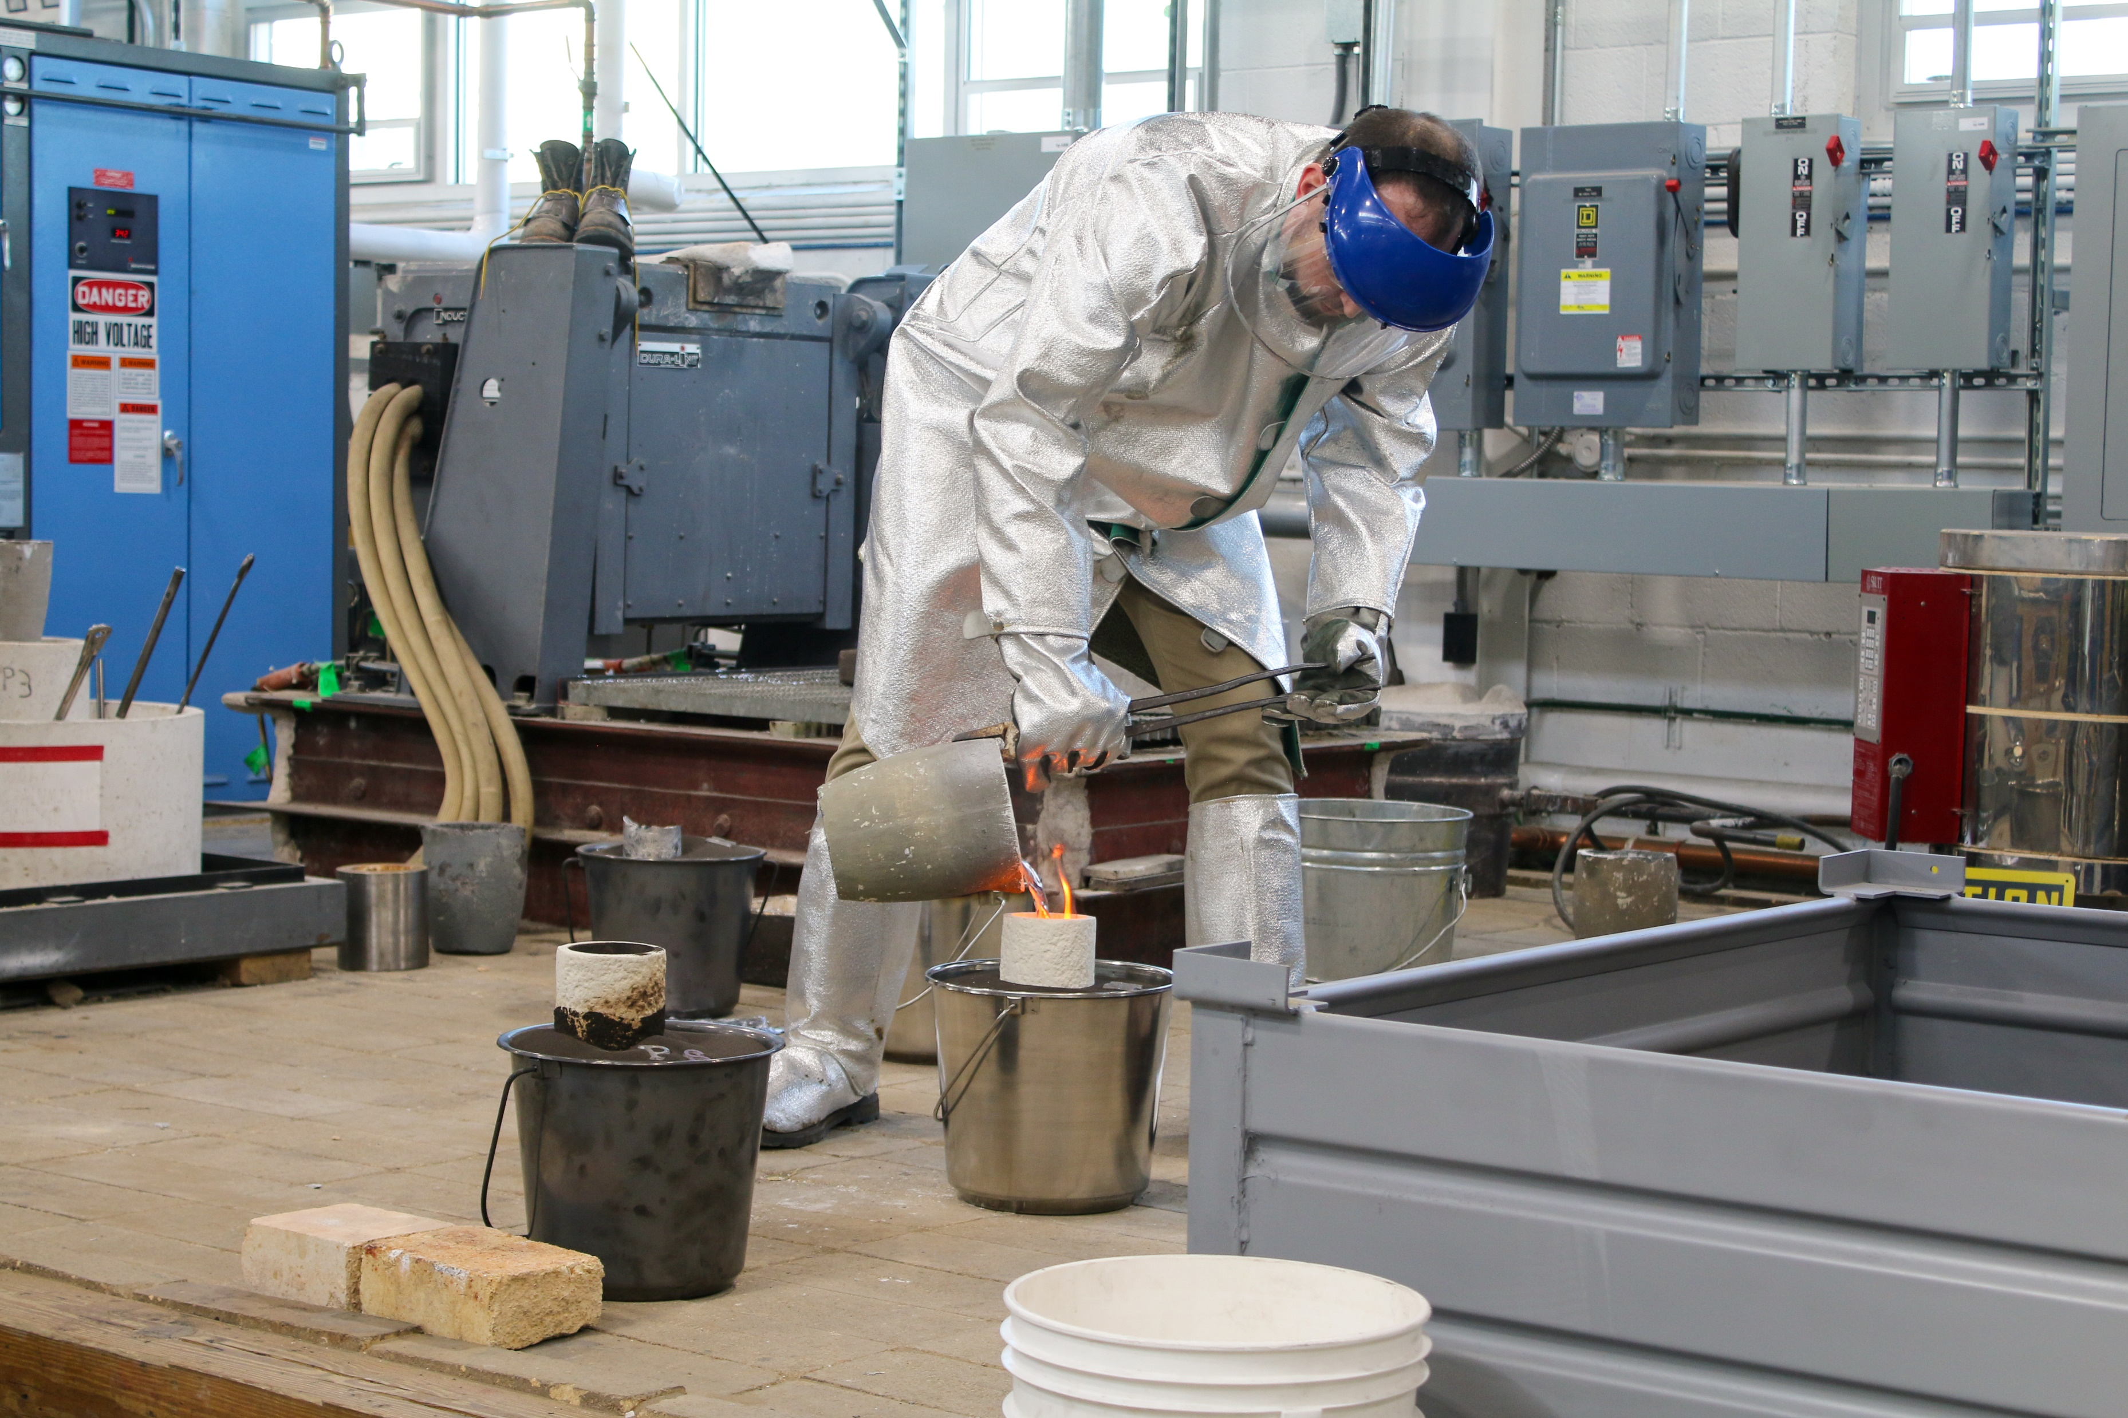

METAL @ OSU
June 9-12
June 23-26*
July 14-17*
July 28-31*
*Housing in University Dorms can be arranged

Slide 15
Questions?
Ryan Petitti
Director of Operations and MELD
Petitti.9@osu.edu, 440-371-8305

Slide 16
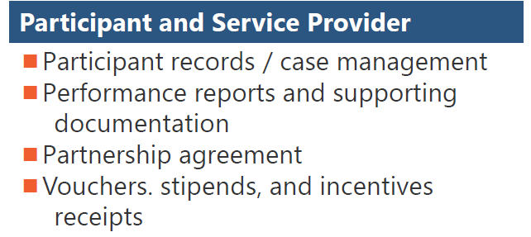

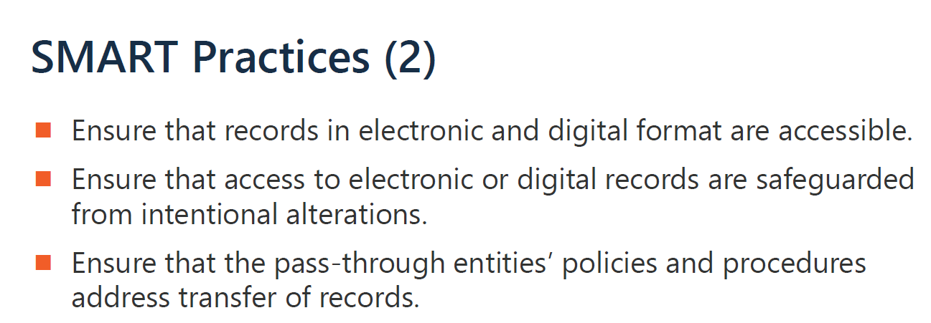
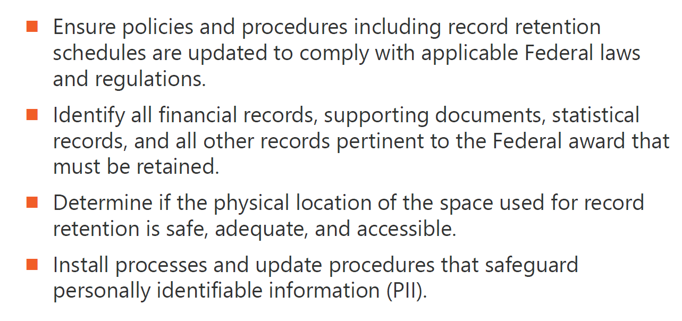
Workforce GPS Training: Records Management
Record Retention Requirements:
Types of itemized records to be retained:
•Financial records,
•Supporting documents,
•Statistical records, and;
•All recipients and subrecipients records.
Add minimum of 3 years from the date of the FINAL Financial expenditure report.
Notes:
https://d2leuf3vilid4d.cloudfront.net/-/media/8626BB26F37F4DFDA0CDBED0E934A0E9.ashx?rev=3F39A712BFB9D992D4C3B8662E61C94A

Slide 17
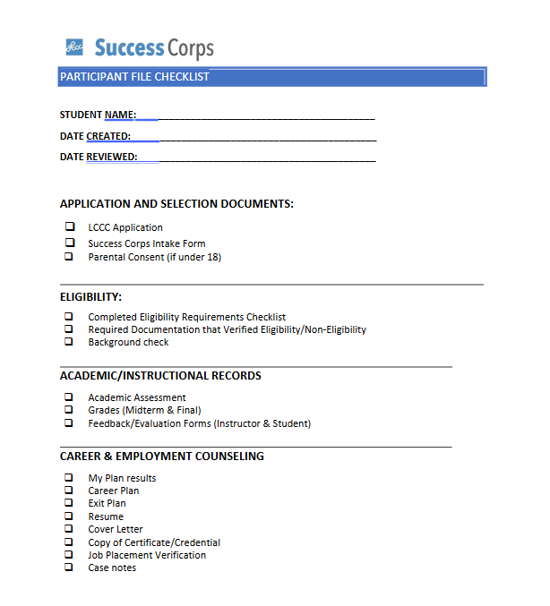
Records Retention &
Data Management
Ohio TechNet can provide technical assistance
Data Management System
Participant Intake Form
Data Sharing Agreement
Data Responsibilities
Data Plan
Data Flow
Notes:
https://d2leuf3vilid4d.cloudfront.net/-/media/8626BB26F37F4DFDA0CDBED0E934A0E9.ashx?rev=3F39A712BFB9D992D4C3B8662E61C94A

Slide 18
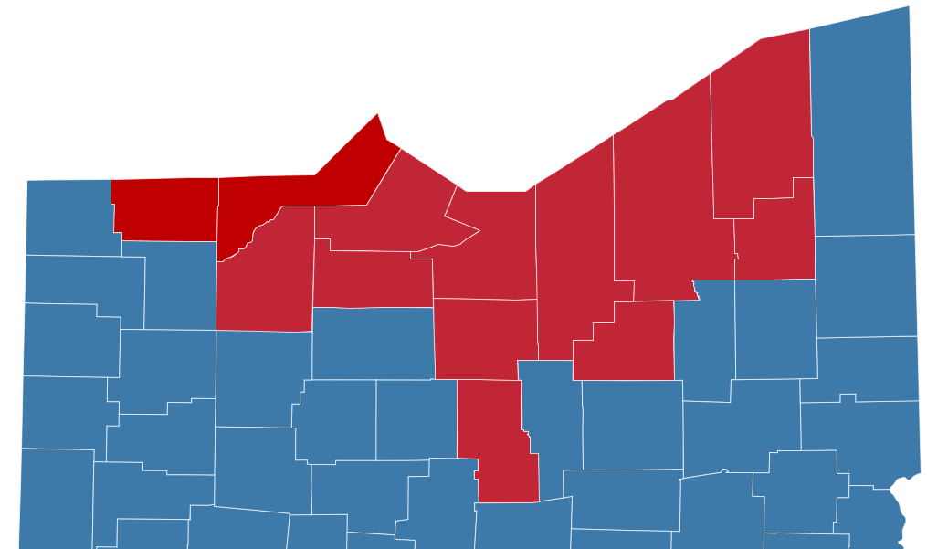
Partners in Training Ohio’s Manufacturing Workforce
Northshore Manufacturing Workforce Partnership (NMWP)
Facilitated by the Ohio Technical Skills Innovation Network (Ohio TechNet), five Northeast and Northwest Ohio community colleges have partnered with state and regional industry leaders to drive innovations designed to meet manufacturing workforce needs, supported by a $5.7M investment from the US Department of Labor Strengthening Community Colleges initiative.
NMWP Program Area

Slide 19
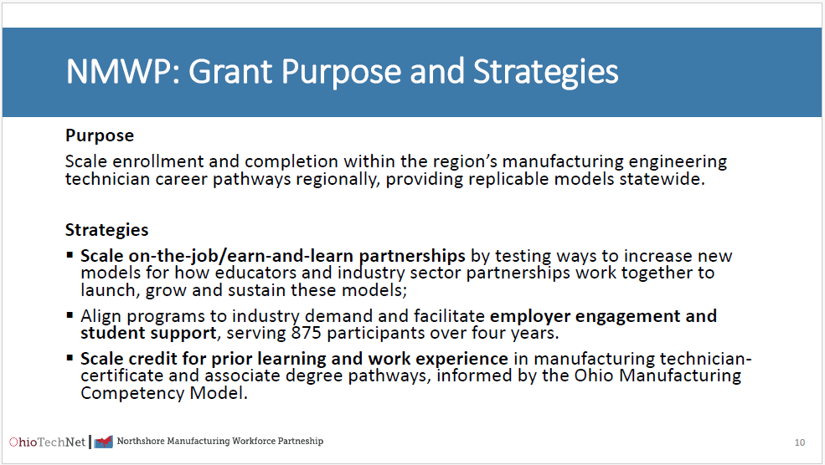
Partners in Training Ohio’s Manufacturing Workforce
Northshore Manufacturing Workforce Partnership (NMWP)
Facilitated by the Ohio Technical Skills Innovation Network (Ohio TechNet), five Northeast and Northwest Ohio community colleges have partnered with state and regional industry leaders to drive innovations designed to meet manufacturing workforce needs, supported by a $5.7M investment from the US Department of Labor Strengthening Community Colleges initiative.

Slide 20
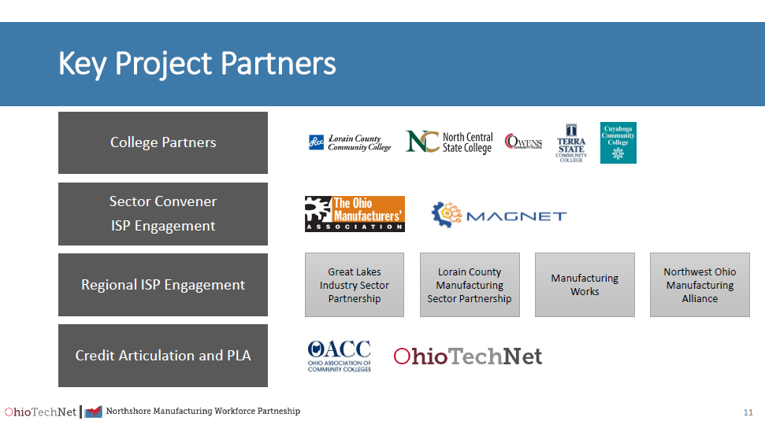
Partners in Training Ohio’s Manufacturing Workforce

Slide 21
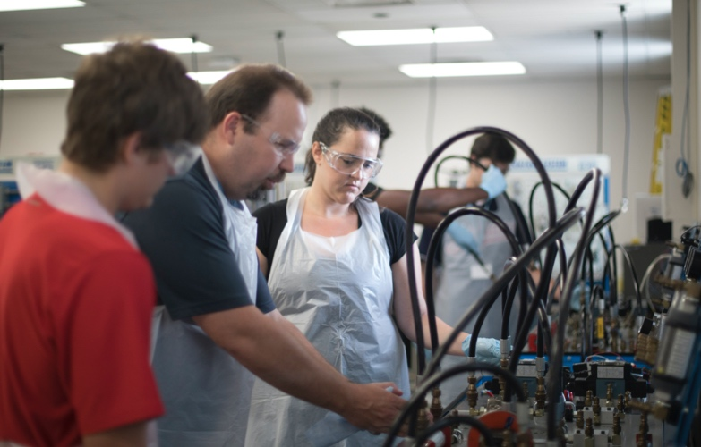

Partners in Training Ohio’s Manufacturing Workforce
May OTN Meeting
May 20, 2025 at 8:30am

